Slide 1
Chad Cumber
Brunswick Interagency Program

Slide 2
Brunswick Community College
Mission
The mission of Brunswick Community College is to provide opportunities for individuals to be successful through accessible, high quality, student-centered programs and services that meet the educational, cultural, and workforce needs of a diverse community.

Slide 3
Brunswick Community College,
Brunswick Interagency Program
BIP Yard Crew
BIP Custodial Crew
ATMC/Focus Broadband
Project Search/Novant
New Projects
Culinary Classes (Servesafe)
Cosmetology Classes (Hair Shampooer & Prep)
Coffee Shop (New Adventure)

Slide 4
Brunswick Community College,
Brunswick Interagency Program
Two Technology Classes (A&B)
A Class-Entry-level computer basics
B Class- Resume building, soft skills and online job searches
PowerPoints
Other digital techology

Slide 5
Best Practices For I/DD Programs
Assistive Technology
IDD students have unique needs and abilities.
Many require assistance to ensure their success in an academic and vocational training environment.
This presentation will address accessibility tools and practices that should be available without request, and will touch on other, reasonable accommodations that may be necessary for individual students.

Slide 6
Preparing for Student Needs
Best Practices For I/DD Programs
Basic software and assistive devices should be included as the IDD student area is prepared for students.
Along with the availability of these items, staff should also be trained in their use.
The initial quantity of each item will be determined by the size of your student body and may vary as student needs become apparent.

Slide 7
Preparing for Student Needs
Regardless of the size of the program, at least one of each tool described in the next section should be available.
Strongly consider installing multiples of some items, as many students will have some manual dexterity or eye/hand coordination needs.
Even for those without these needs, accessibility modifications will provide an ease of use and therefore remove barriers to learning.

Slide 8
Assess Student Needs
A conversation addressing technological needs should be included in each student’s intake process. A review of the student’s high school IEP and other documents can provide a starting point for this discussion. At a minimum, areas such as dexterity, dyslexia, low-vision, color-blindness, and low-hearing should be discussed.
If a student has specific needs not addressed through the standard accessibility tools available in the program, outside agencies such as Vocational Rehabilitation, can be included in the discussion.

Slide 9
Basic Technology Needs and Existing Technologies
The goal of the technologies listed are to provide support for the typical needs generally found within the IDD population.
While no list (or program) can anticipate all the needs students will have, the following should address the basic needs of most students.
Most items will need to be purchased; others have free versions or are included within an operating system, etc.

Slide 10
Basic Technology Needs and Existing Technologies
After inventorying existing software and hardware to identify needs, include the campus Information Technologies(IT) department for assistance in the purchasing process. This will ensure that all materials will be compatible with existing hardware/software.
The following list should be considered as a starting point.

Slide 11
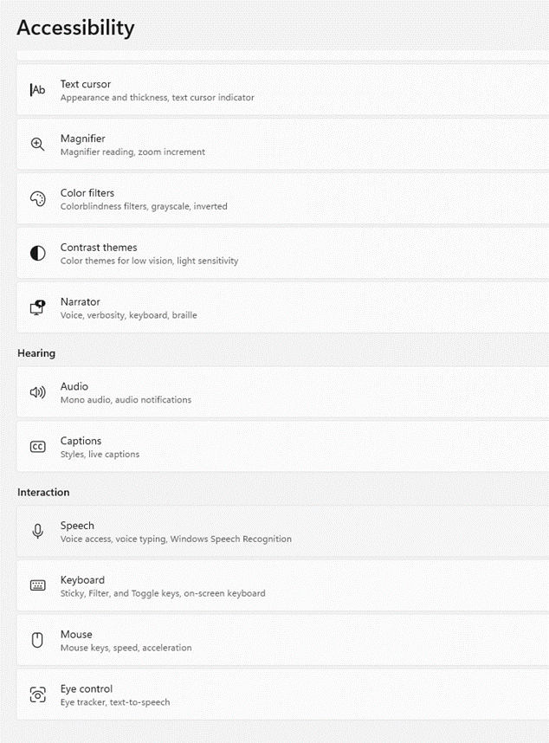
Visual Accessibility
Visual accessibility
Screen reader
Speech to text software
Screen magnifier
Adjustable accessibility settings (typically built into a PC)

Slide 12


Visual Accessibility
Screen readers are software programs designed to read information on the screen and reproduce it either via speech or Braille. While JAWS is a popular screen reader brand, it does have a relatively high cost. NVDA is a free screen reader from NV Access and it is designed by the blind for the visually impaired

Slide 13

Visual Accessibility
Speech to text software translates the spoken word to text. Dragon is a common paid product that has been available for 25 years. Versions include both a downloadable version and a mobile cloud-hosted version. Free options include both Microsoft (Speech Recognition) and Apple (Dictation) which have the speech to text ability built into their products. Google also has a free text to speech app, but currently must be used within the Chrome browser.

Slide 14
Visual Accessibility
Screen magnifiers typically enlarge a portion of the screen and Macs , PCs , and Chromebooks have this capability built into their software.
In most cases these capabilities are sufficient for students’ needs.
One note, there are downsides to screen magnifiers. It takes practice to be able to navigate while changing the focus area and this may be disorienting to students. Introduce students to the magnification capability slowly for the best result.

Slide 15



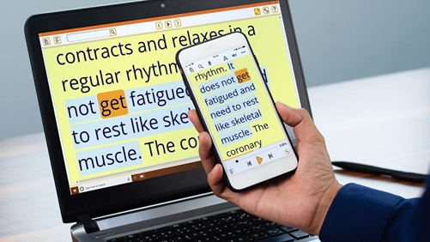
Visual Accessibility
Paid screen magnifier software include MAGic , ZoomText , and Supernova.

Slide 16
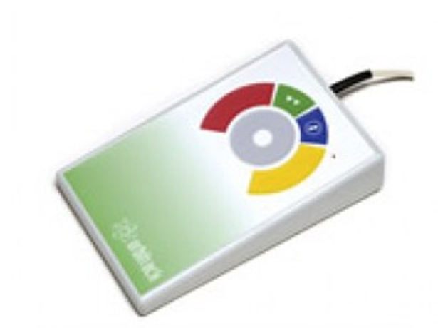
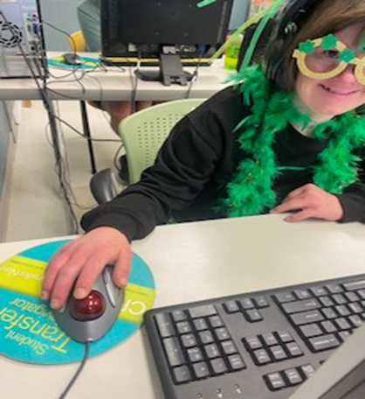
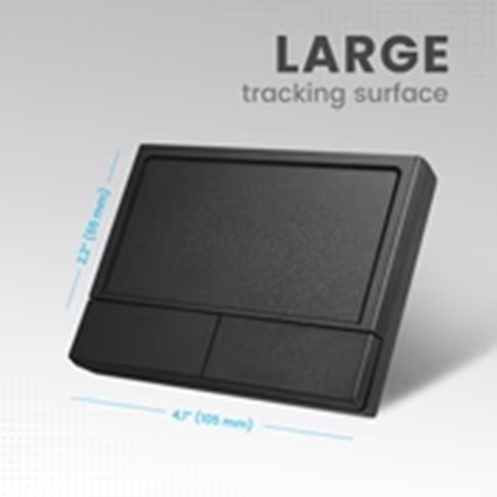
Spatial/Dexterity Accessibility
Touchpads or other mouse substitutes can range from the standard integrated laptop touchpad or specialized mouse substitutes.
External touchpads are also available.

Slide 17
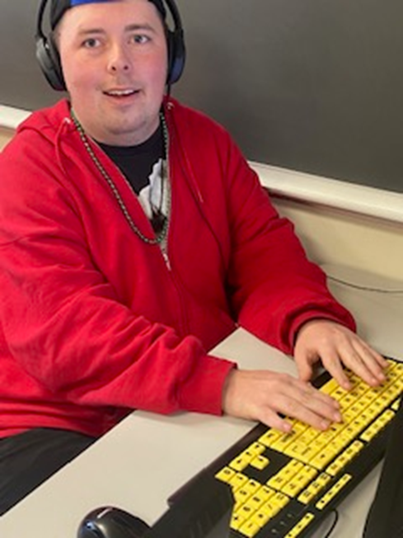
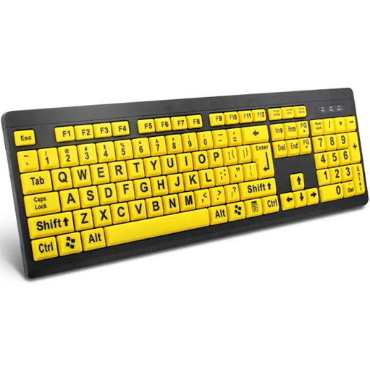
Spatial/Dexterity Accessibility
Large key/high contrast print keyboards.

Slide 18
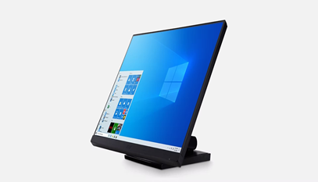
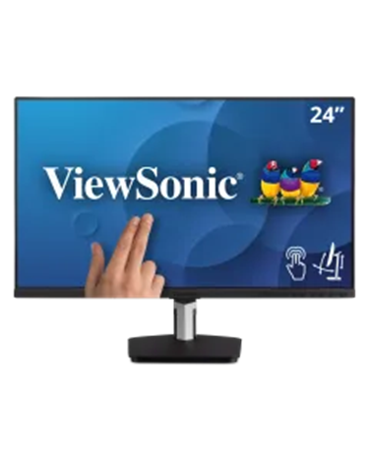
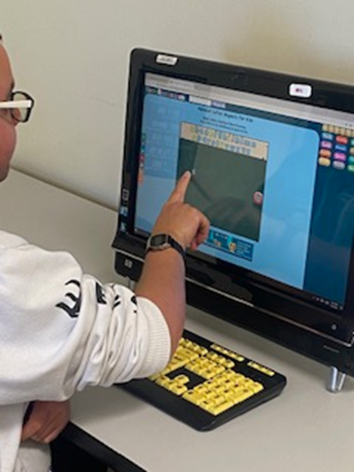
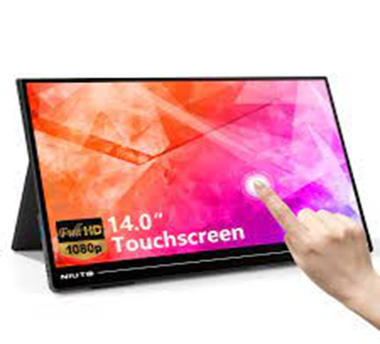
Spatial/Dexterity Accessibility
Touchscreen monitors are available from many brands.

Slide 19
Audio Needs
Headphones are available from various brands and styles.
If students will be sharing headphones, a supply of disposable headset covers is strongly recommended.
Closed captioning is required for all videos. Captioning can be generated by using various sites and software including YouTube and Camtasia (Windows version only). Windows has an auto-generated caption capability using Stream an online streaming service.

Slide 20
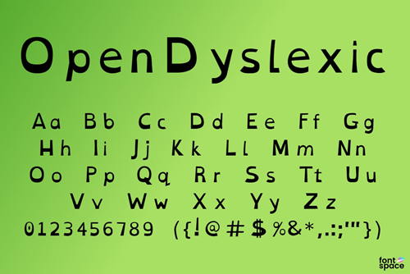
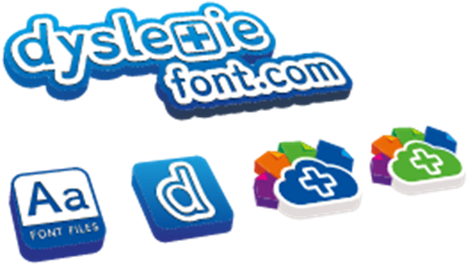
Learning Disabilities
Spelling and grammar checkers are typically included within common word processing software including MS-Office and GoogleDocs , but are also available as a separate service such as Grammarly.
Fonts designed for dyslexics such as Dyslexie and Open-Dyslexic use slight weighting, spacing, and other differences to make differentiating letters easier for those with dyslexia.

Slide 21
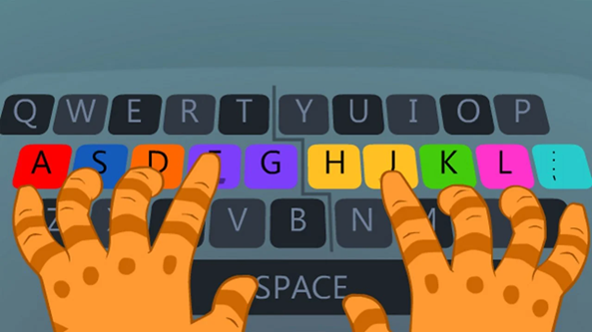

Software – Increase Technology Skills and Comfort Levels
In order to utilize many technologies, the need for students to know how to type is paramount. There are websites which provide lessons, tests, and games to foster learning typing skills.
Jigsaw puzzles also help students learn in a fun manner. While completing the puzzles, students learn to control the mouse (or substitute) and keys and/or operate a touchscreen which is a necessary skill for computer usage.

Slide 22
Funding Sources
A college’s regular budget as well as its equipment budget can be used to purchase the items described in this section. Additional funding may be available from your college’s Foundation.
North Carolina has several agencies that provide assistance to individuals with a disability. A lengthy list of these agencies may be found on the Olmstead Rights website and includes the Aging and Disability Resource Centers (ADRC), Vocational Rehabilitation, and the NC Assistive Technology Program.
Two other agencies of interest are the Administration for Community Living and the ATIA Funding Resources Guide .

Slide 23
Professional Development
Professional development will be necessary for instructors and staff to ensure the best implementation possible for students.
The use and application of the various products (screen readers; alternate mouse devices; voice recognition/speech to text software; etc.
How to match student needs with the available products.
The Americans with Disabilities Act as it relates to making information accessible to people with disabilities (digitally or in print).

Slide 24


ASSISTIVE TECHNOLOGIES RESOURCE PAGE
http://www.ncatp.org/
https://www.ncdhhs.gov/divisions/vocational-rehabilitation-services/north-carolina-assistive-technology-program

Slide 25


ASSISTIVE TECHNOLOGIES RESOURCE PAGE
https://thinkcollege.net/resource-search?search_api_views_fulltext+assistive+technology
www.cidd.unc.edu/services/default.aspx?id=28

Slide 26
Thank You
Special thanks to Ann Harrison, Director of Distant Learning, Ret.
Please feel free to email me to request a copy of the PowerPoint presentation and/or the references
Chad Cumber
Assistant Director
Brunswick Interagency Program, Brunswick Community College
cumberc@brunswickcc.edu

