Slide 1

Rowan-Cabarrus Community College Food Service Program
Chris Hartley, Program Manager
Chris.Hartley@rccc.edu
Stephanie Dunlap, Food Service Instructor
Stephanie.Dunlap@rccc.edu

Slide 2
Basic Skills Career Pathways
Adult Basic Education (ABE)
Adult High School
English as a Second Language
S.O.A.R. Program (Skills, Opportunity, Awareness, Readiness )
* The S.O.A.R program focus is on helping Adults with Intellectual Disabilities
  become more independent and self-directing by acquiring basic literacy, social and life skills needed to function successfully in daily living.
Adding Occupational Pathways
  Manufacturing
  Logistics
  Food Service

Slide 3
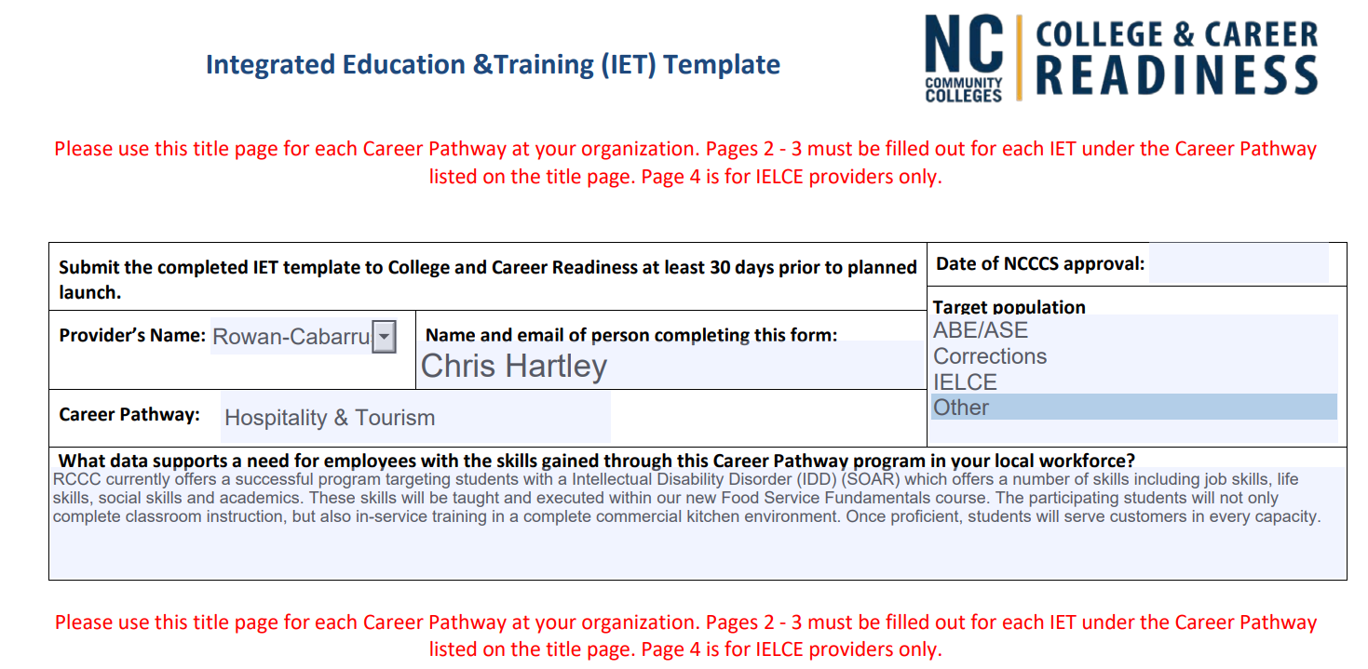

Slide 4

Concept
A student-staffed café that provides hands-on training to S.O.A.R. students and food service for students, employees, and campus guests
  Completers and current students from S.O.A.R and ABE programs participate in an occupational extension (OE) course with applied learning intended to provide occupational training.
A unique combination of a food service enterprise and a community college course
  Students prepare food, serve food, cashier, and maintain a clean and safe environment, while providing customer service to patrons.
  The café operates on the South Campus of RCCC with planned operating hours Monday through Thursday 8:30 am to 1 pm.
  The classes meet between 8:00 AM until 1:30 PM to allow for set-up and closing operations while service is closed to the public.
Authentic training experiences for students
  S.O.A.R. and ABE students will have completed their program of study, reaching Comprehensive Adult Student Assessment System (CASAS) or Test of Adult Basic Education (TABE) levels consistent with the relevant job specifications for Food Preparation Workers (35-2021.00), Food Preparation and Serving Related Workers, All Other (35-9099.00) or other relevant job classifications.

Slide 5
Mission
To provide occupational skills training for S.O.A.R. students:
  Learn transferable skills to the hospitality industry
  Learn life-skills to use at home, work, and social settings
  Leads to ServSafe Food Handler Credential
To give students, staff, and guests a place to eat on campus:
  Competitive, convenient, cost effective, sustainable, and socially conscious
To increase exposure for the general public:
  Opportunity for S.O.A.R. students to be introduced to work-environments in the hospitality industry
  Opportunity for S.O.A.R. students to identify marketable, work-related strengths
  Opportunity for General Public to interact with SOAR population

Slide 6
Values
Demonstrate Sustainability
  Buy only sustainable products
Optimize the Unique Abilities of Students
  Consider Student preferences, interests, and strengths
  Review unused skills and how they can fit into workflow operations
  Find value in passion and skills and match them to opportunity
Affordability
  Convenient and cost-effective
  On-Campus food options
  Ensure students are ready to learn by eliminating hunger

Slide 7
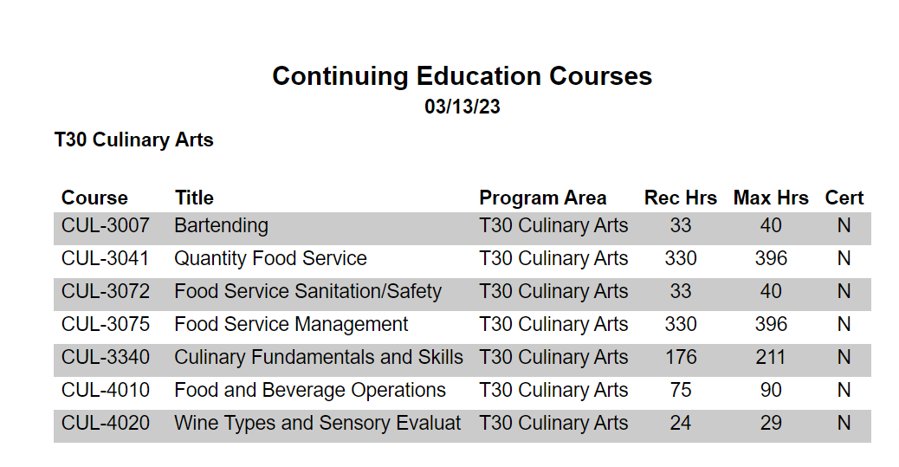
T30 Culinary Arts

Slide 8
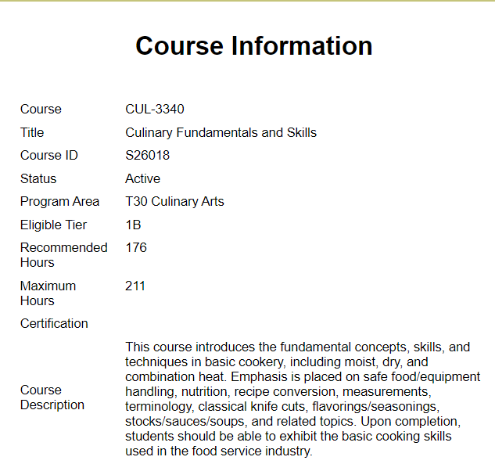
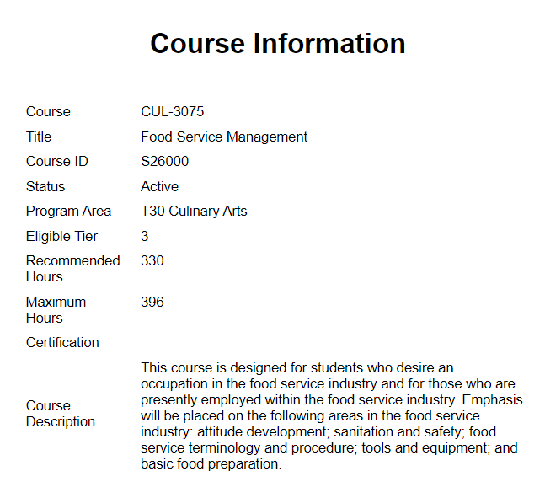
CUL-3340 or CUL-3075

Slide 9
Name of Class: Food Service Fundamentals
Course: CUL-3340
T30 Culinary Arts
132 hours presently (maximum 211)
Cost of Class: $180 plus $2.43 for insurance for a total of $182.43
(scholarships provided)
Description: This course introduces fundamental concepts, skills, and techniques related to basic food service. The course will include basic understanding of Customer Service, Money/Cashiering, Food Preparation, Replenishment, Sanitation, Cooking/Grilling, and Personal Hygiene. Upon completion of the course, students should be able to exhibit the basic food service fundamentals used in the food service industry.

Slide 10
Customer Service
Money/Cashiering
Food Handling and Preparation
Replenishment
Sanitation
Cooking/Grilling
Personal Hygiene
The program utilizes UNC-CH TEACCH Program for Continuous Support/Guidance
  Recommends different teaching styles to ensure student engagement and success
Measurable Skills

Slide 11

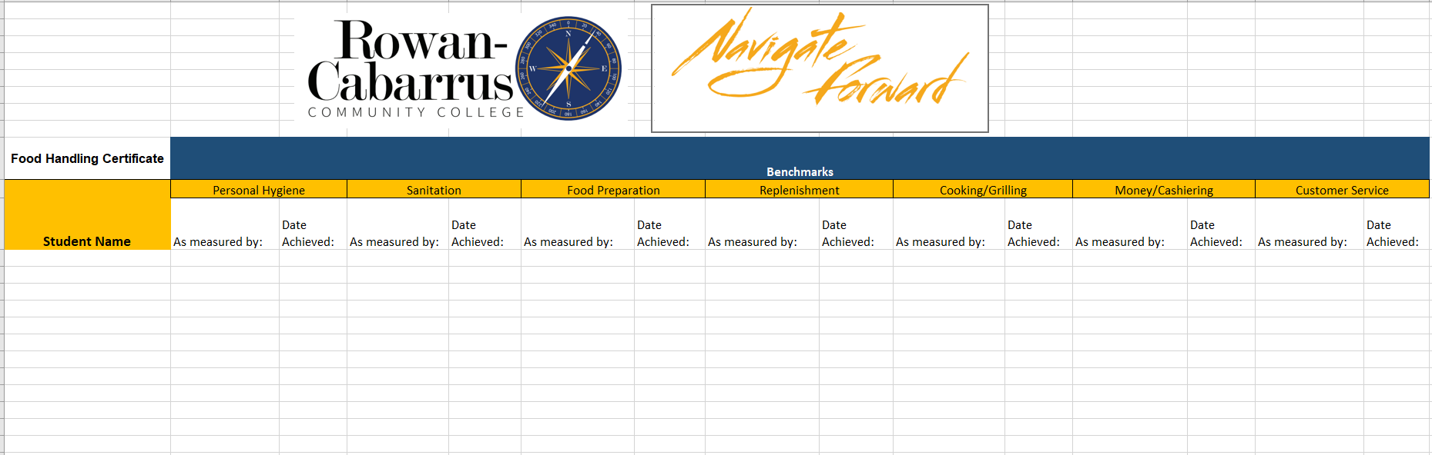
Benchmarks Spreadsheet

Slide 12
College Departments Collaboratively Involved
Basic Skills/S.O.A.R. (Student Recruitment and Engagement)
Occupational Extension (Programming and Instruction)
Information Technology (Square and Other Classroom/Café Tech Setup)
Business Office (Purchasing, Vendors, Posting Revenue)
Facilities (Maintenance and Repair of Facilities and Equipment)
Marketing and Graphics (Promotion)
Library Services (Resources)
Cooperative Education (Work Study Support)

Slide 13
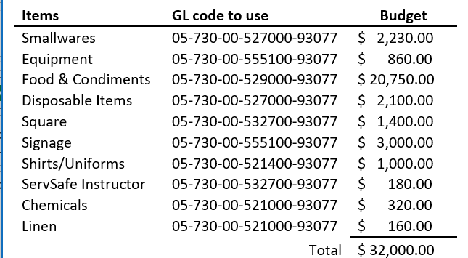
Example Café Start-Up Budget
Revenue
The primary source of operational revenue will come from the sales of the food and drink.
The primary source of funding for course delivery will come from Occupational Extension FTE earned.
Costs
Since the café is a combination of a class and a service, the budget has two major components for operation—1) those expenses and revenues related to delivery of the course and 2) expenses and revenues related to food production and service.

Slide 14
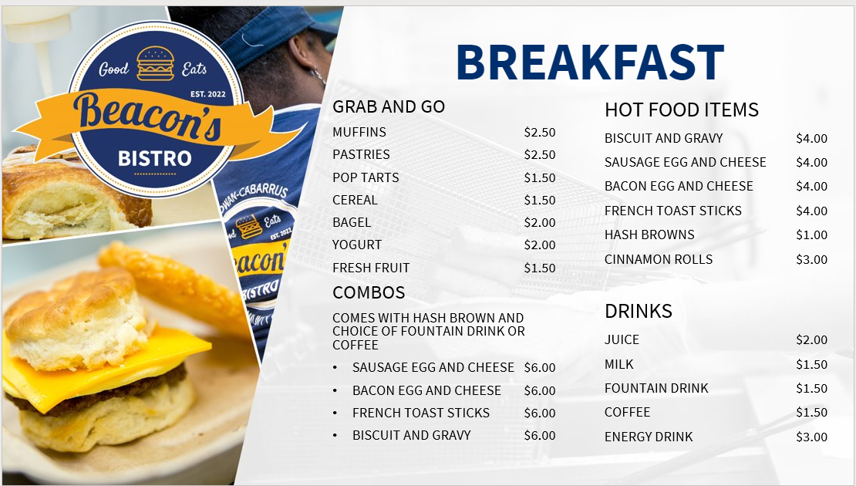

Slide 15
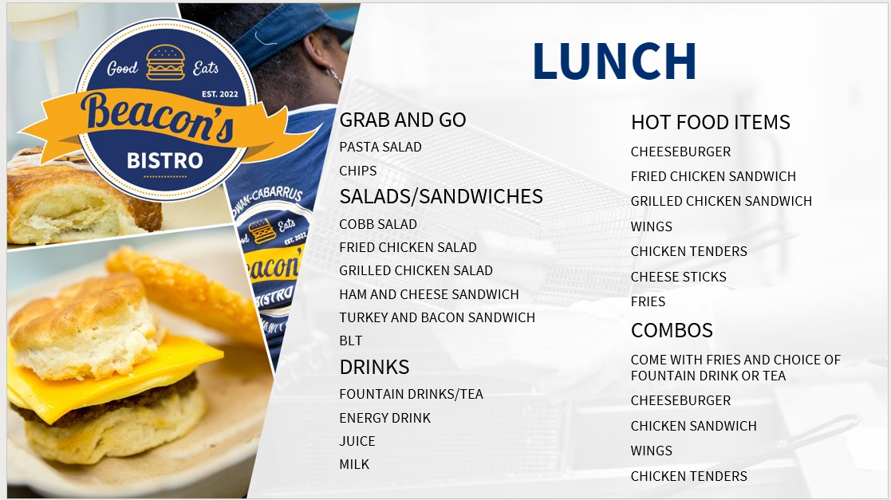

Slide 16
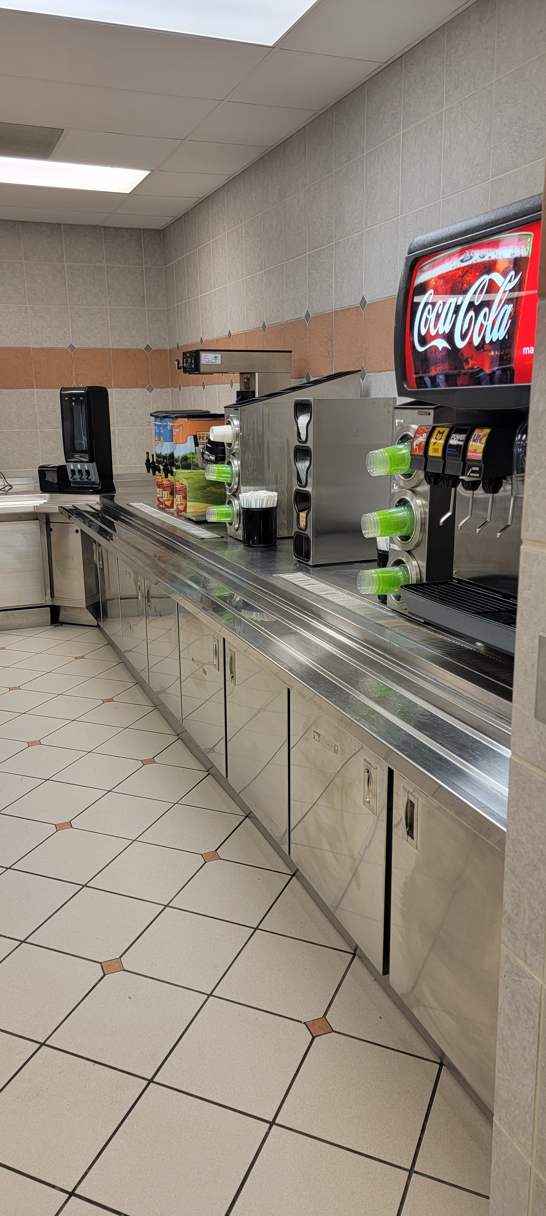
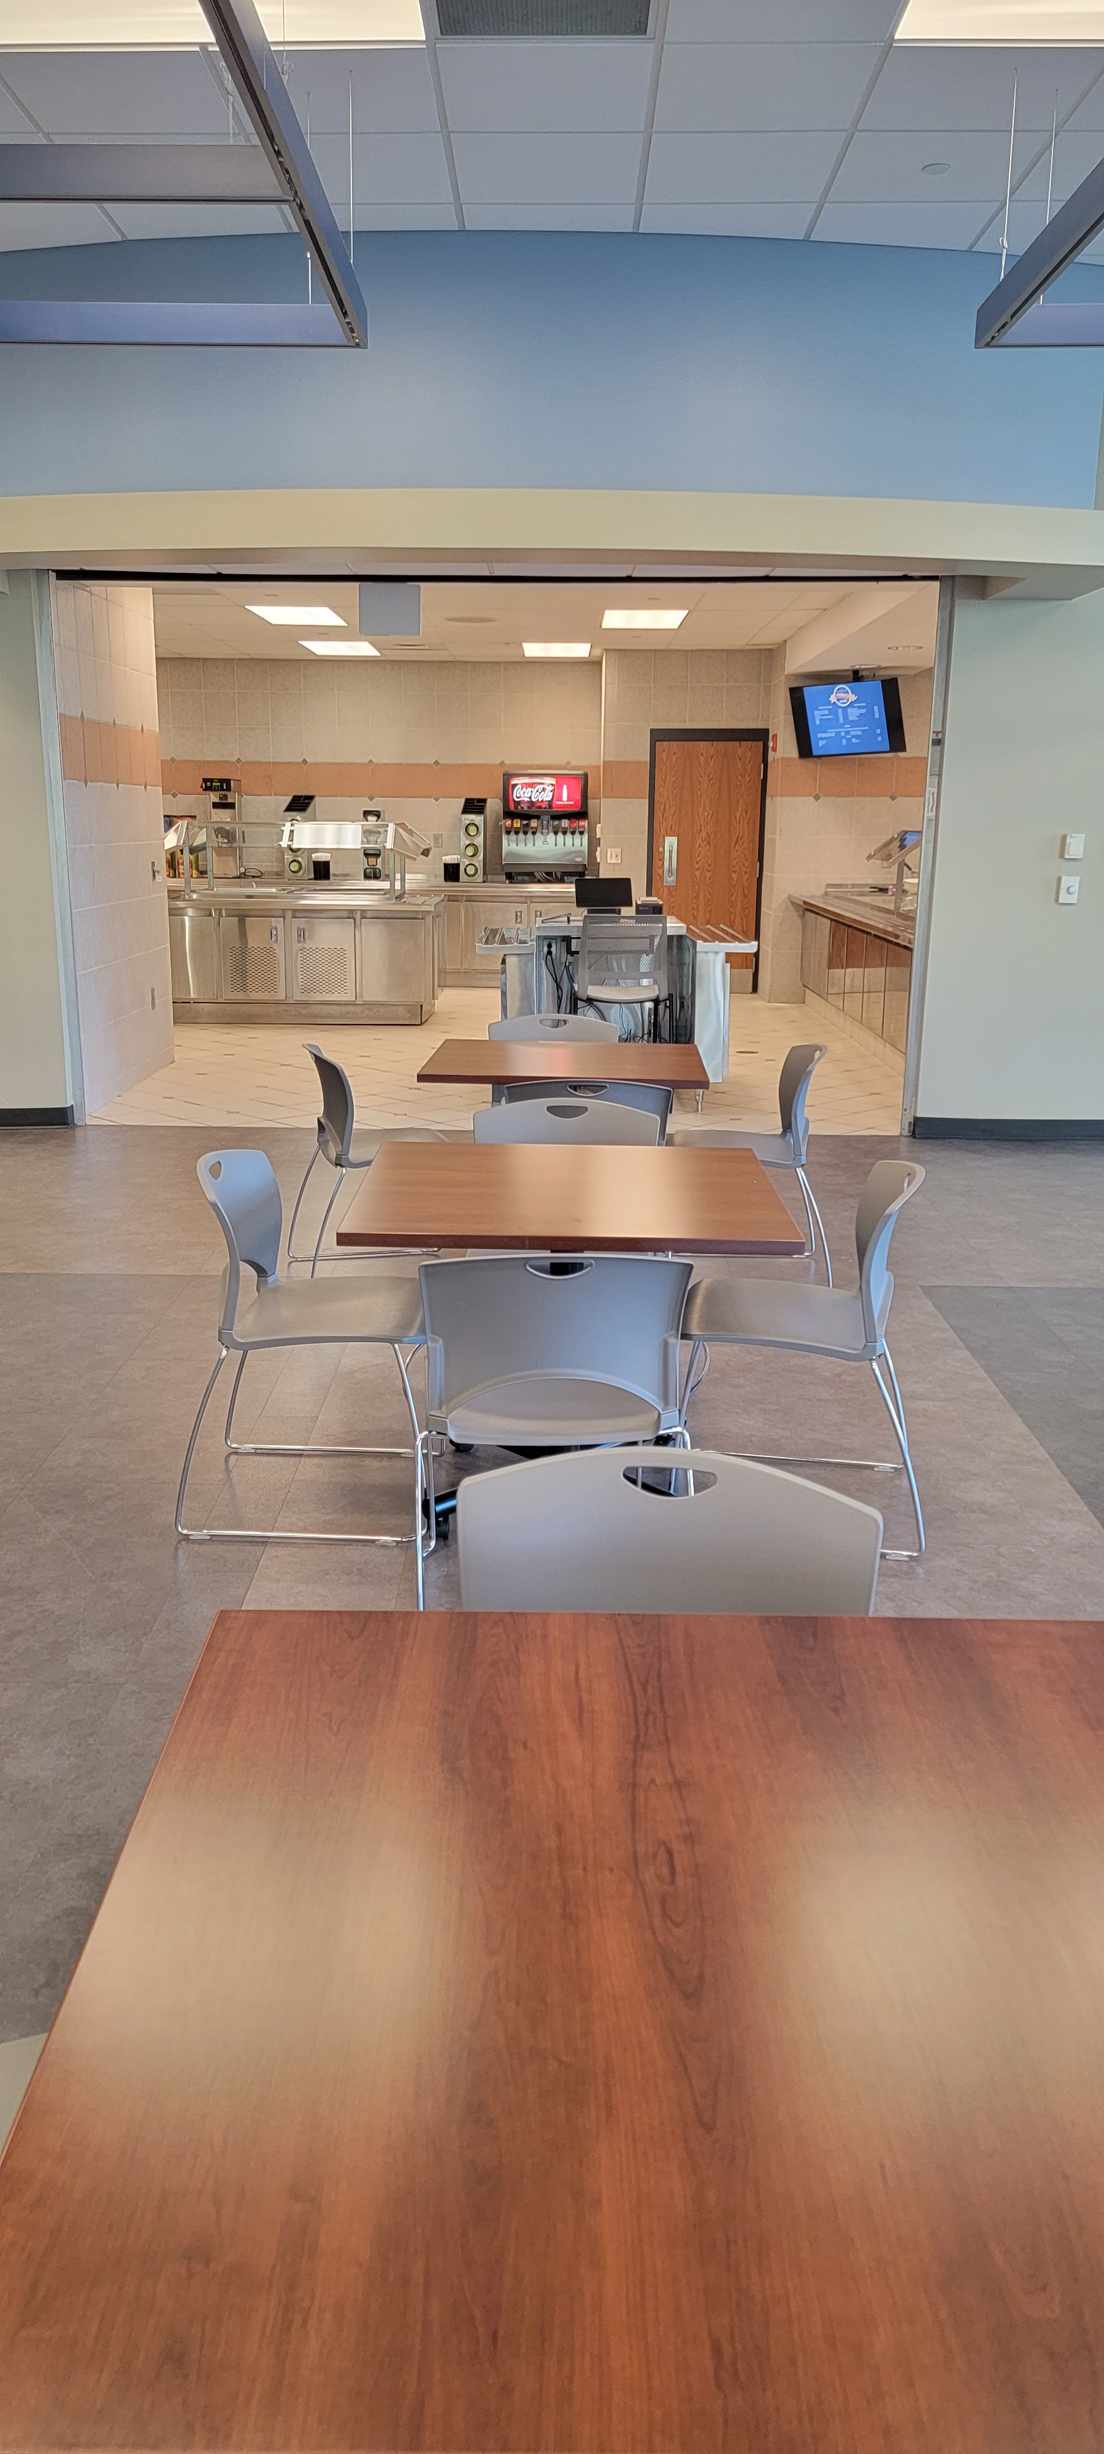
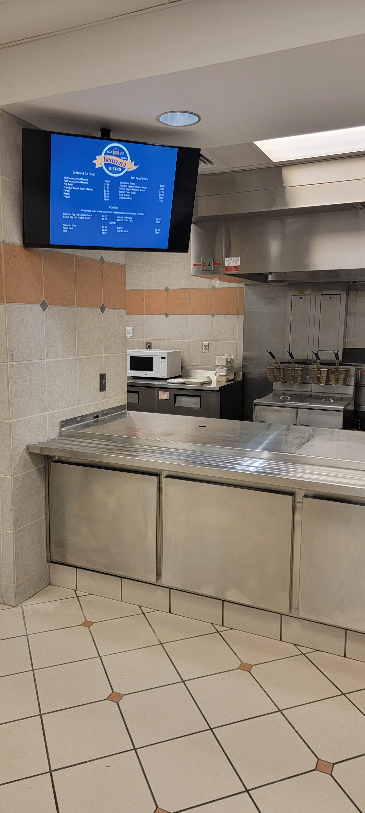

Slide 17

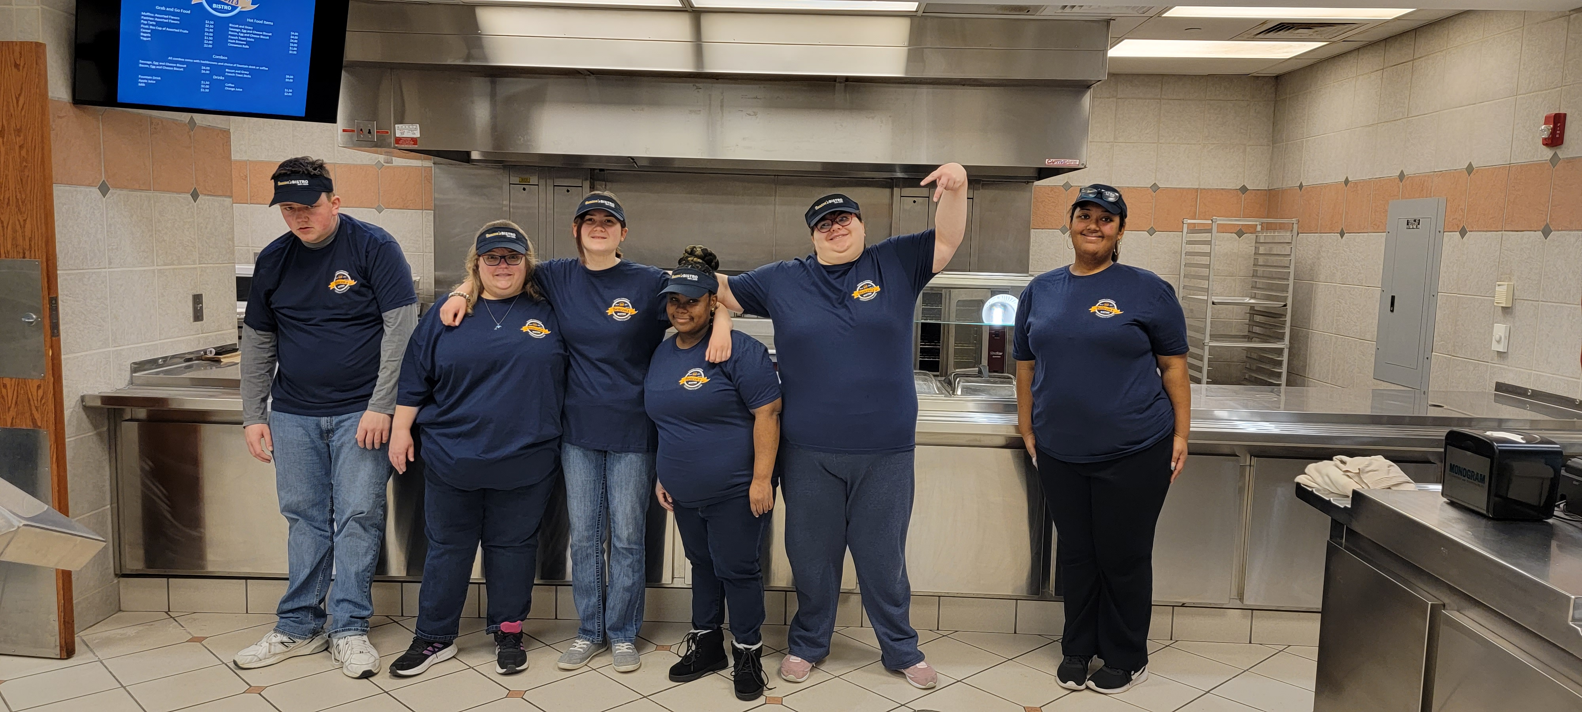

Slide 18
Curriculum and Activity Ideas
ServSafe® - ServSafe® - ServSafe Food Handler
Georgia Food Service Curriculum –
  https://dph.georgia.gov/sites/dph.georgia.gov/files/WIC_Resources/Dietetic_Internship/School%20Food%20Service%20Curriculum.pdf
USDA PowerUp Curriculum –
  https://snaped.fns.usda.gov/snap/PowerUp/PowerUpCurriculum.pdf
Food Service Manager Certification North Carolina –
  foodmanageronline.com
Free Online Learning at GCFGlobal (Goodwill Community Foundation)
Sporcle - A World of Quizzes
UNC-CH TEACCH

Slide 19
Textbook Ideas and Resources
Teaching Authentic Cooking Skills to Adults with Intellectual and Developmental Disabilities: Active Engagement (ISBN 978-0-9965068-8-5)
On Cooking: A Textbook of Culinary Fundamentals (pearson.com) - Pearson (ISBN 978-0134441900)
Life Skills Activities for Secondary Students with Special Needs (ISBN 9780470538487)
The Professional Chef - Wiley (ISBN 9780470421352)
Systematic instruction for students with moderate and severe disabilities (ISBN 978-1598571936)
Journal Article - https://www.researchgate.net/publication/299373625_Teaching_Food_Safety_Skills_to_Students_with_Disabilities

Slide 20
Cooking and Food Resources Provided By Our RCCC Librarians
Accessible Chef: visual recipes, a recipe creator to help you make your own visual recipes, and resources on things like pre-cooking skills and adaptive cooking tools - https://accessiblechef.com/
Bry-Backmanor: This has some more visual recipes focusing on symbols instead of pictures - http://www.bry-backmanor.org/picturerecipes.html
Kanopy
  The Everyday Gourmet: Rediscovering the Lost Art of Cooking - https://www.kanopy.com/en/rccc/video/149863
  The Everyday Gourmet: Cooking with Vegetables - https://www.kanopy.com/en/rccc/video/1113190
Microwave Cooking: https://etd.ohiolink.edu/apexprod/rws_etd/send_file/send?accession=osu1365932246&disposition=inline
Breezy Special Ed: http://www.breezyspecialed.com/2016/05/how-to-incorporate-cooking-lessons-into.html
My World Kitchen (4 part - series)
BBC Teach Food Preparation and Nutrition (9 videos)
Make IT series (cooking and crafts)

Slide 21
Money Lesson Ideas Provided By Our OTA Work Study Student
Prevent students from being overwhelmed and allow for thorough conversation. Math can be complicated and requires a lot of attention. Conduct lessons over several days, based on time constraints and students’ needs. Here are worksheets to help teach money math.
  https://specialneedsresourceblog.com/tag/math-worksheets
  https://www.math-drills.com/money.php
Bring real money for practice counting. Show how dimes are the smallest coins and quarters are the largest in size. Discuss the value of each coin with the help of the worksheets and how many would make one U.S. dollar. Allow students to spend time counting out their coins and tell each other how much they have. Incorporate dollar bills.
Create a pretend shopping trip; this is a great way to teach the expectations of a cashier. Set up items on three desks (pens, books, pencils, and boxes). Have teachers stand behind desks telling students that they're the cashiers. Instruct students to shop off the desks, bring the items they wanted, and “ring them up." (For fun, you can label the tables: candy, fruit, vegetables, and juices). Have teachers ask students to pay with the money they have. (To keep them involved and fun, make pretend cash register noises). After they are done shopping, ask if someone wants to volunteer as cashier and teachers be the customers. Here, you can test their learning; for example, by having the teachers pretend they don't have enough money so the students can brainstorm and apply their knowledge.

