Slide 1


Slide 2
Project Search History
Started in 1996 because of a need.
From one original site at Cincinnati Children’s Hospital to over 400 sites both domestic and international.
Southwestern Community College was selected as a site in 2014.

Slide 3
About our program
Three host sites
Forty-three lives changed
Diverse internship opportunities
Job Placements – each year we have placed 80 to 100%
Proud of our retention rate - 90%

Slide 4
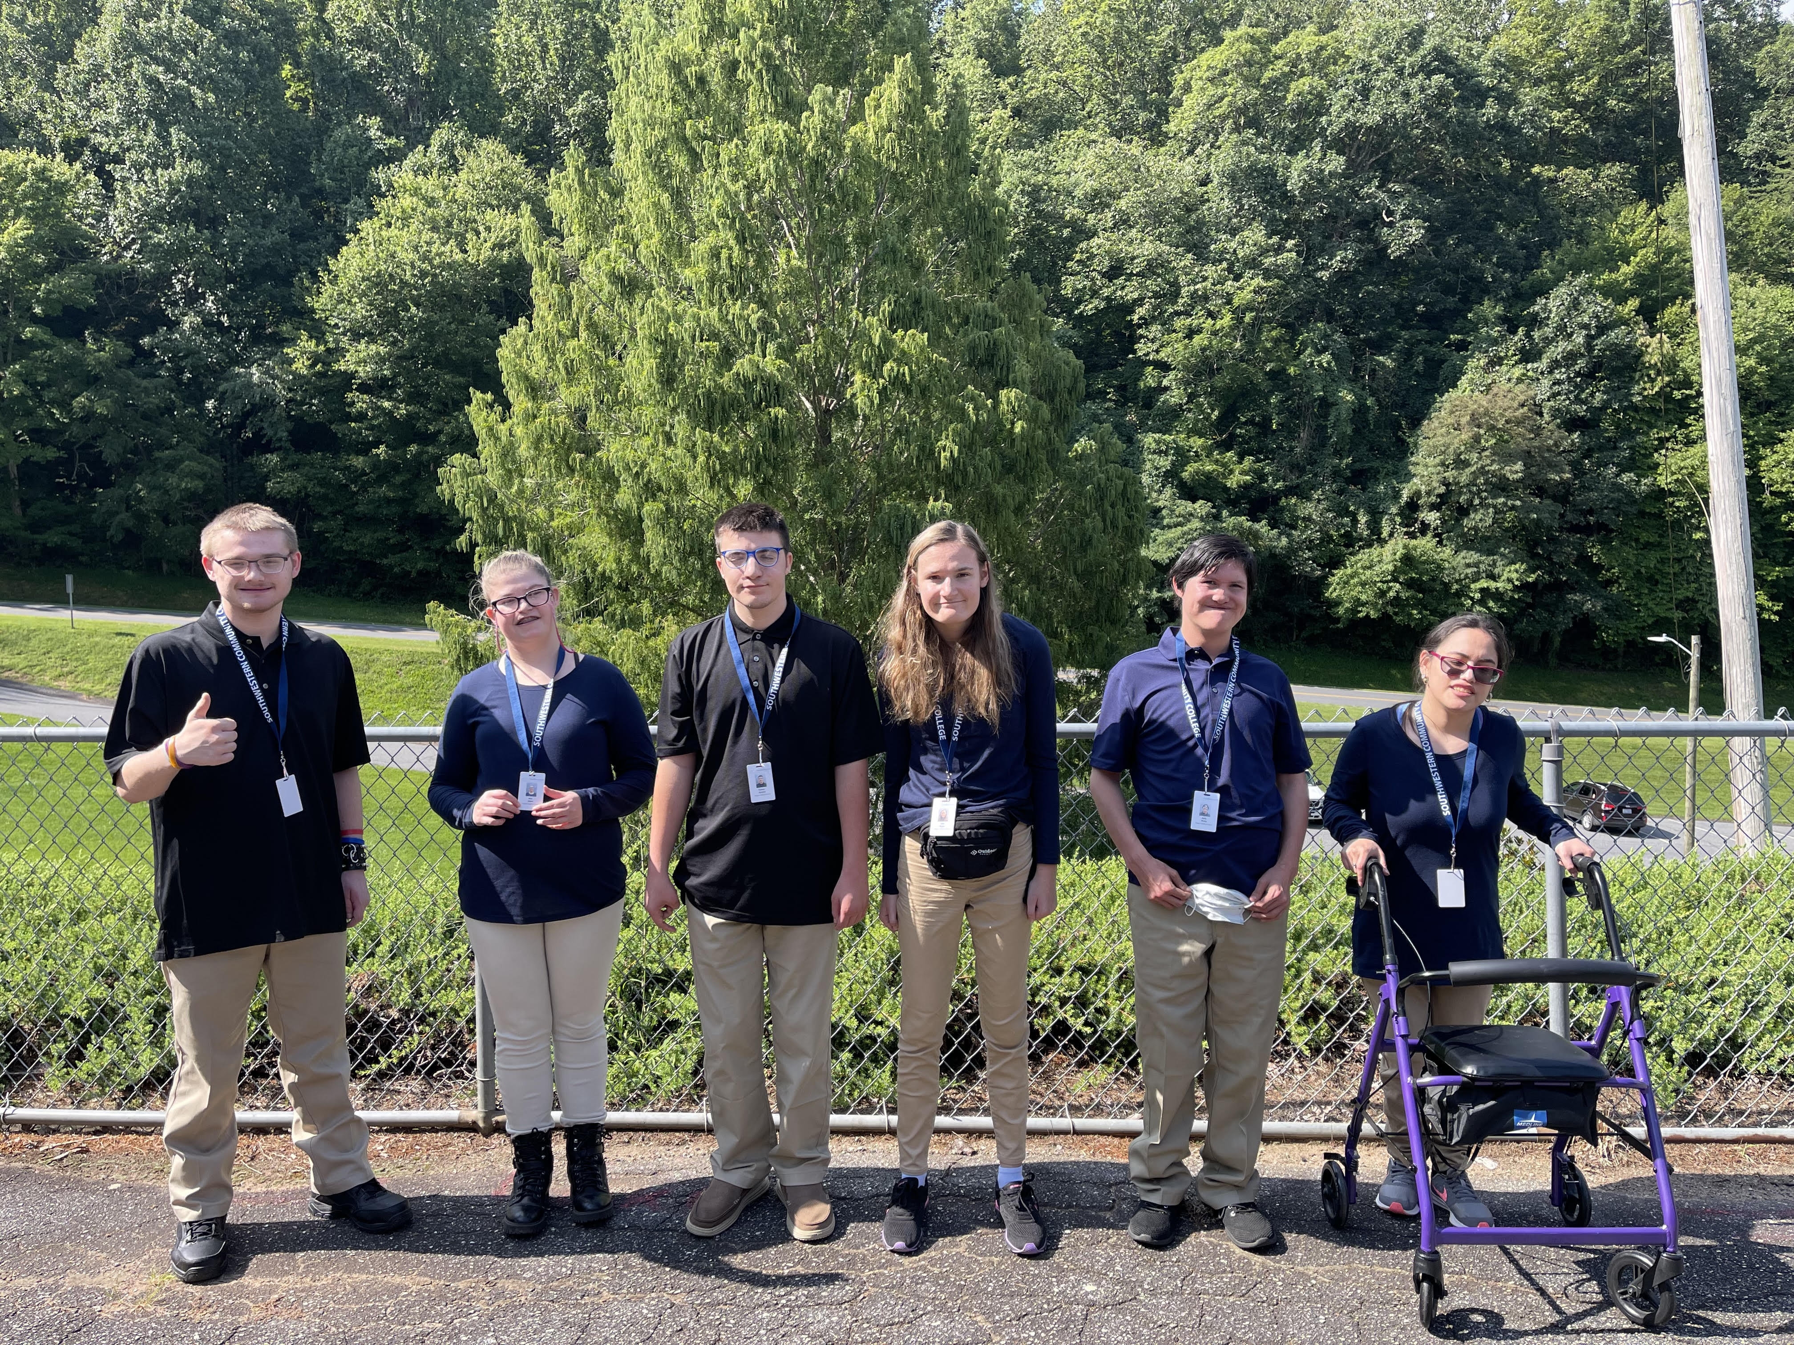
2022 – 2023 Project SEARCH Interns

Slide 5
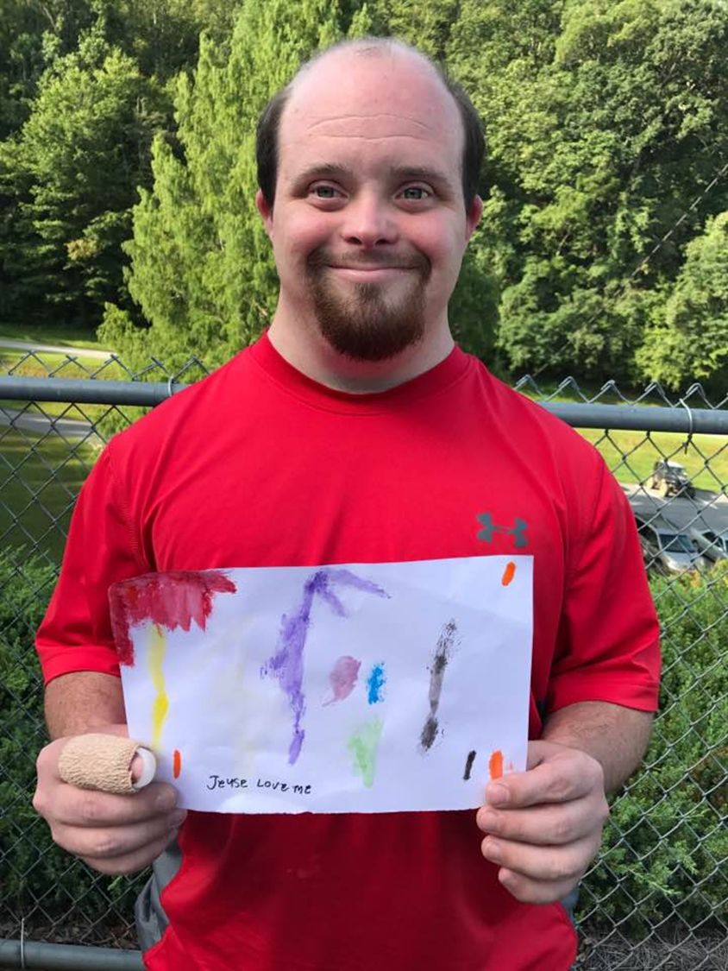
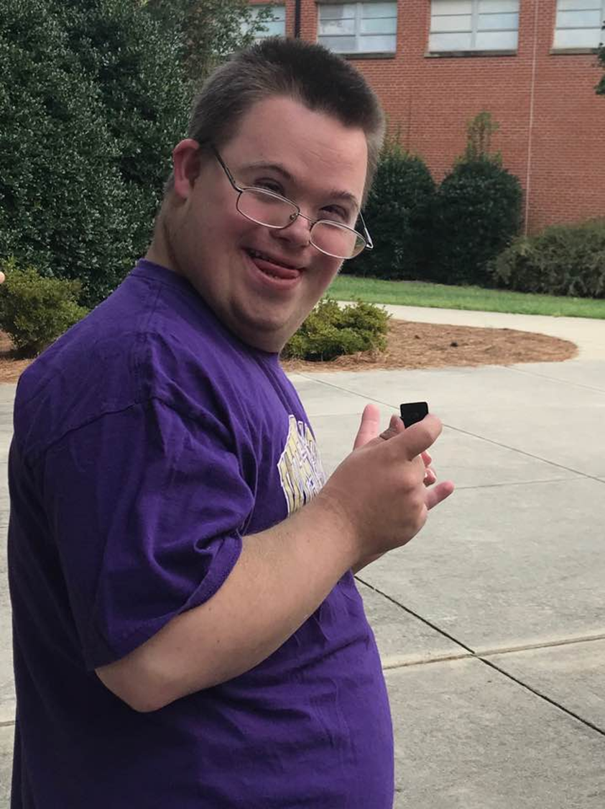
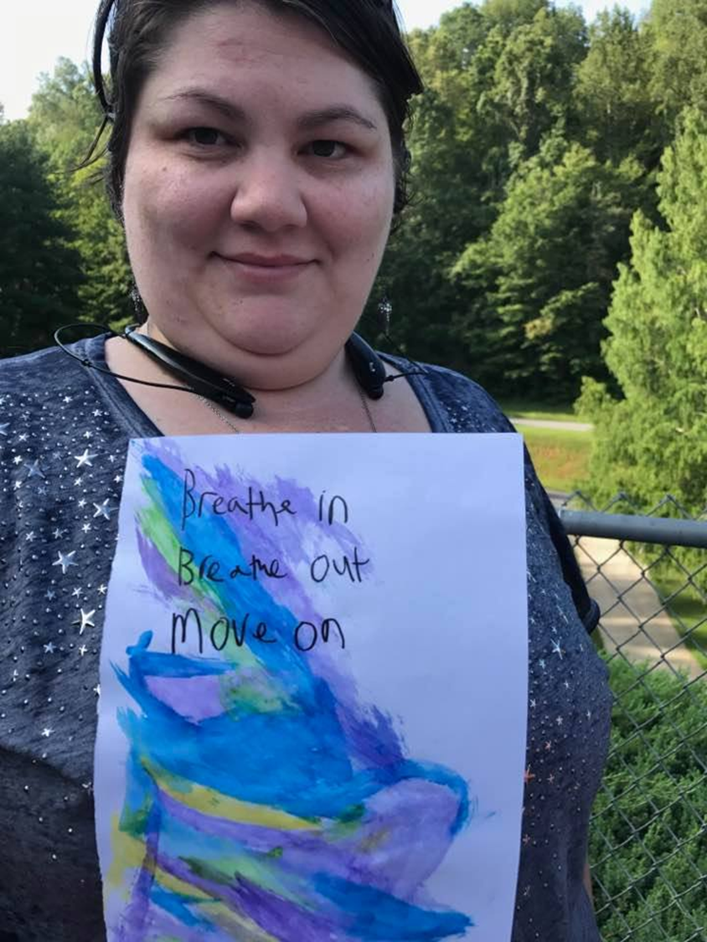
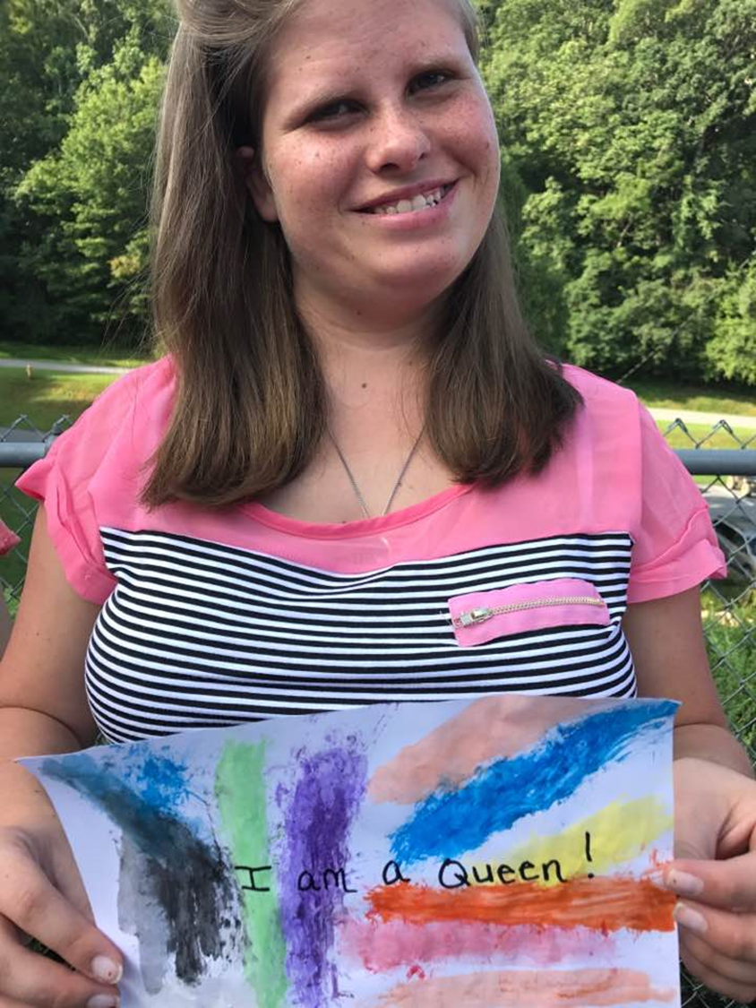
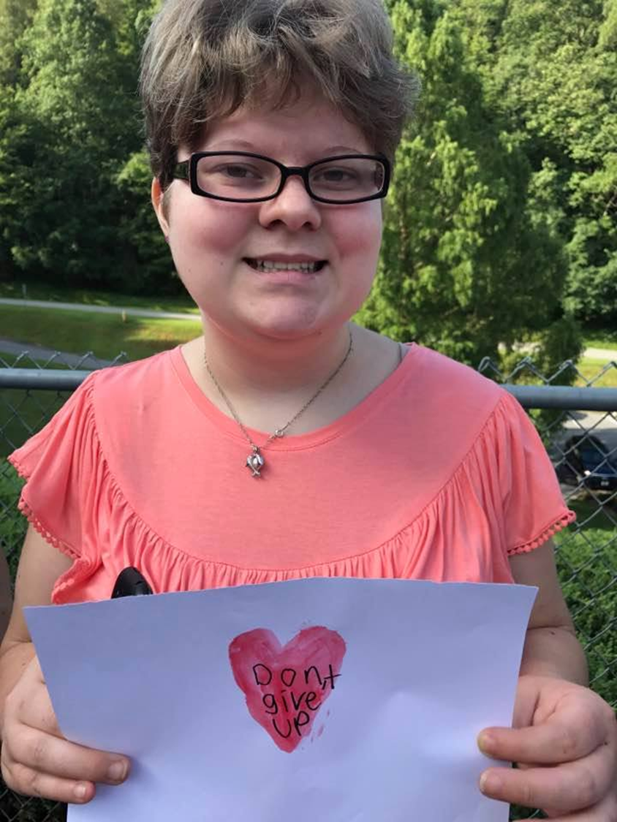
Interns
Our interns come in all types: we have served and placed successfully those with different types of intellectual and developmental disabilities: Downs, Autism, Cerebral Palsy, Fetal Alcohol Syndrome and Traumatic brain injury.

Slide 6
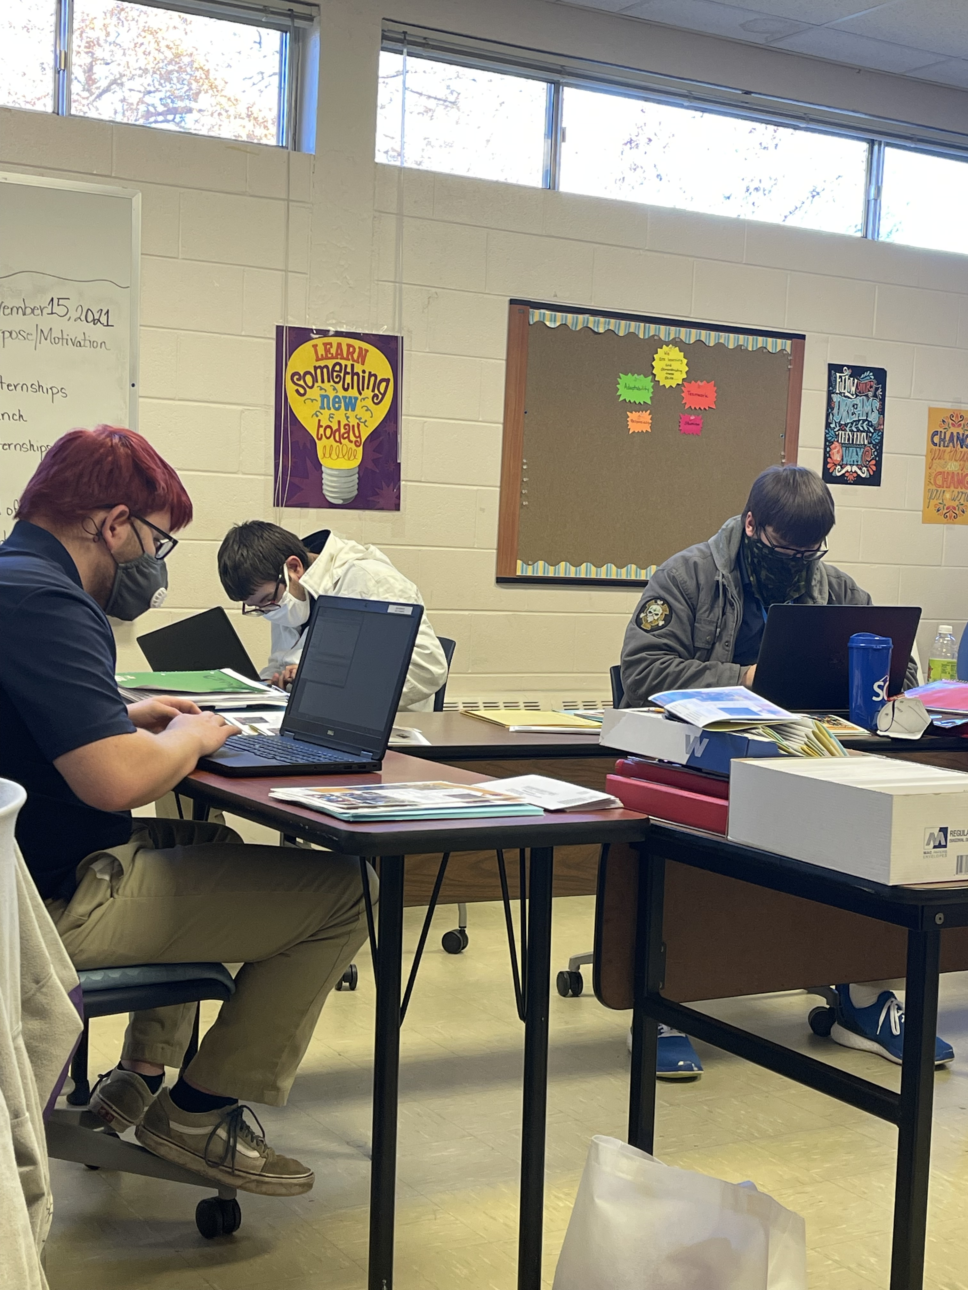
Classroom Time
Our students receive contextualized teaching utilizing Project SEARCH curriculum and adhering to the NCCCS content standards.
Topics include: teamwork, workplace safety, self-advocacy, health and wellness, financial literacy, technology, preparing for employment, maintaining employment.
*Self-awareness, goal setting, soft skills

Slide 7
Implementing what is learned in class
Skills Assessment
Internships
Job Skills Trainers
Help with job placement
Follow along job coaching upon graduation

Slide 8
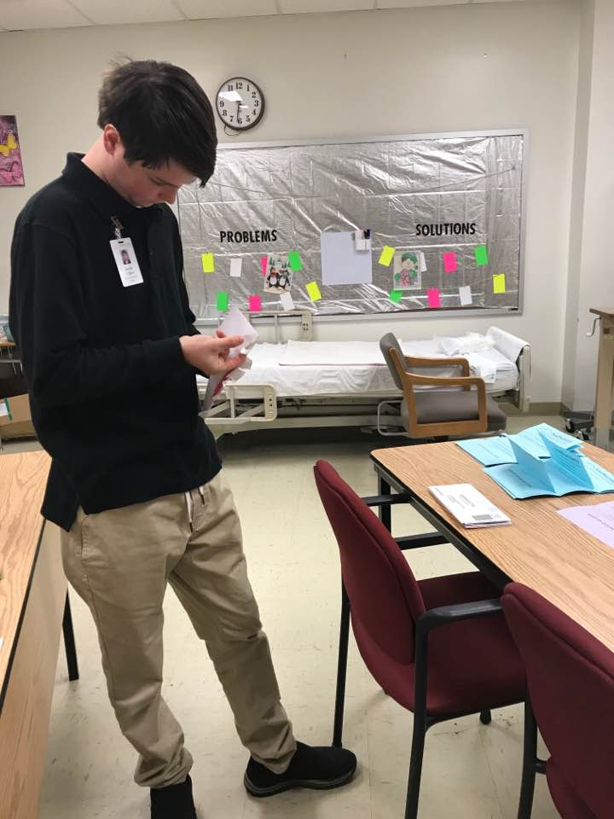
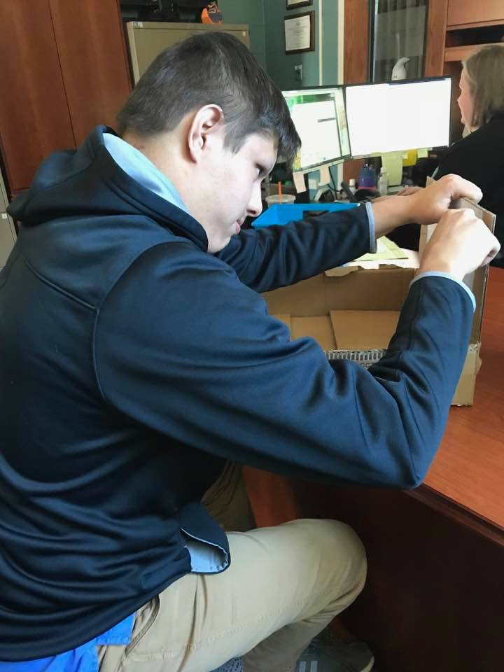
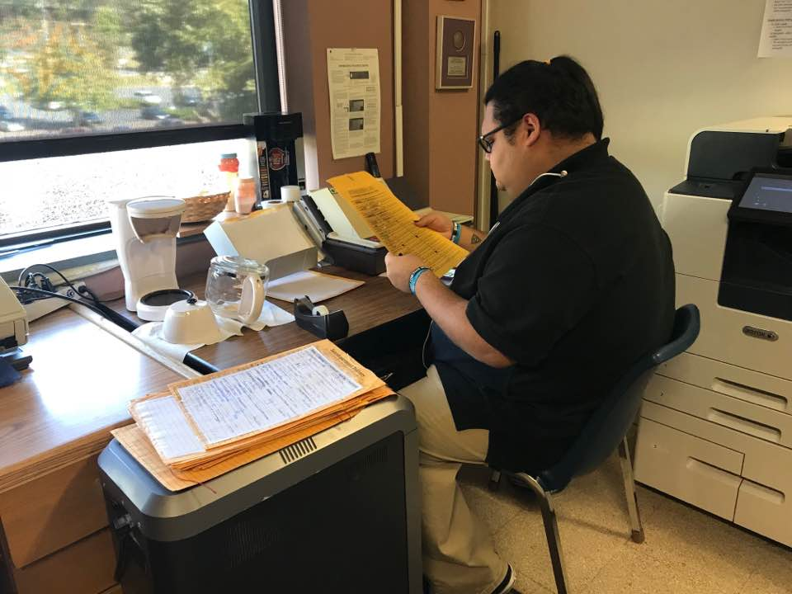
Interns at Work

Slide 9
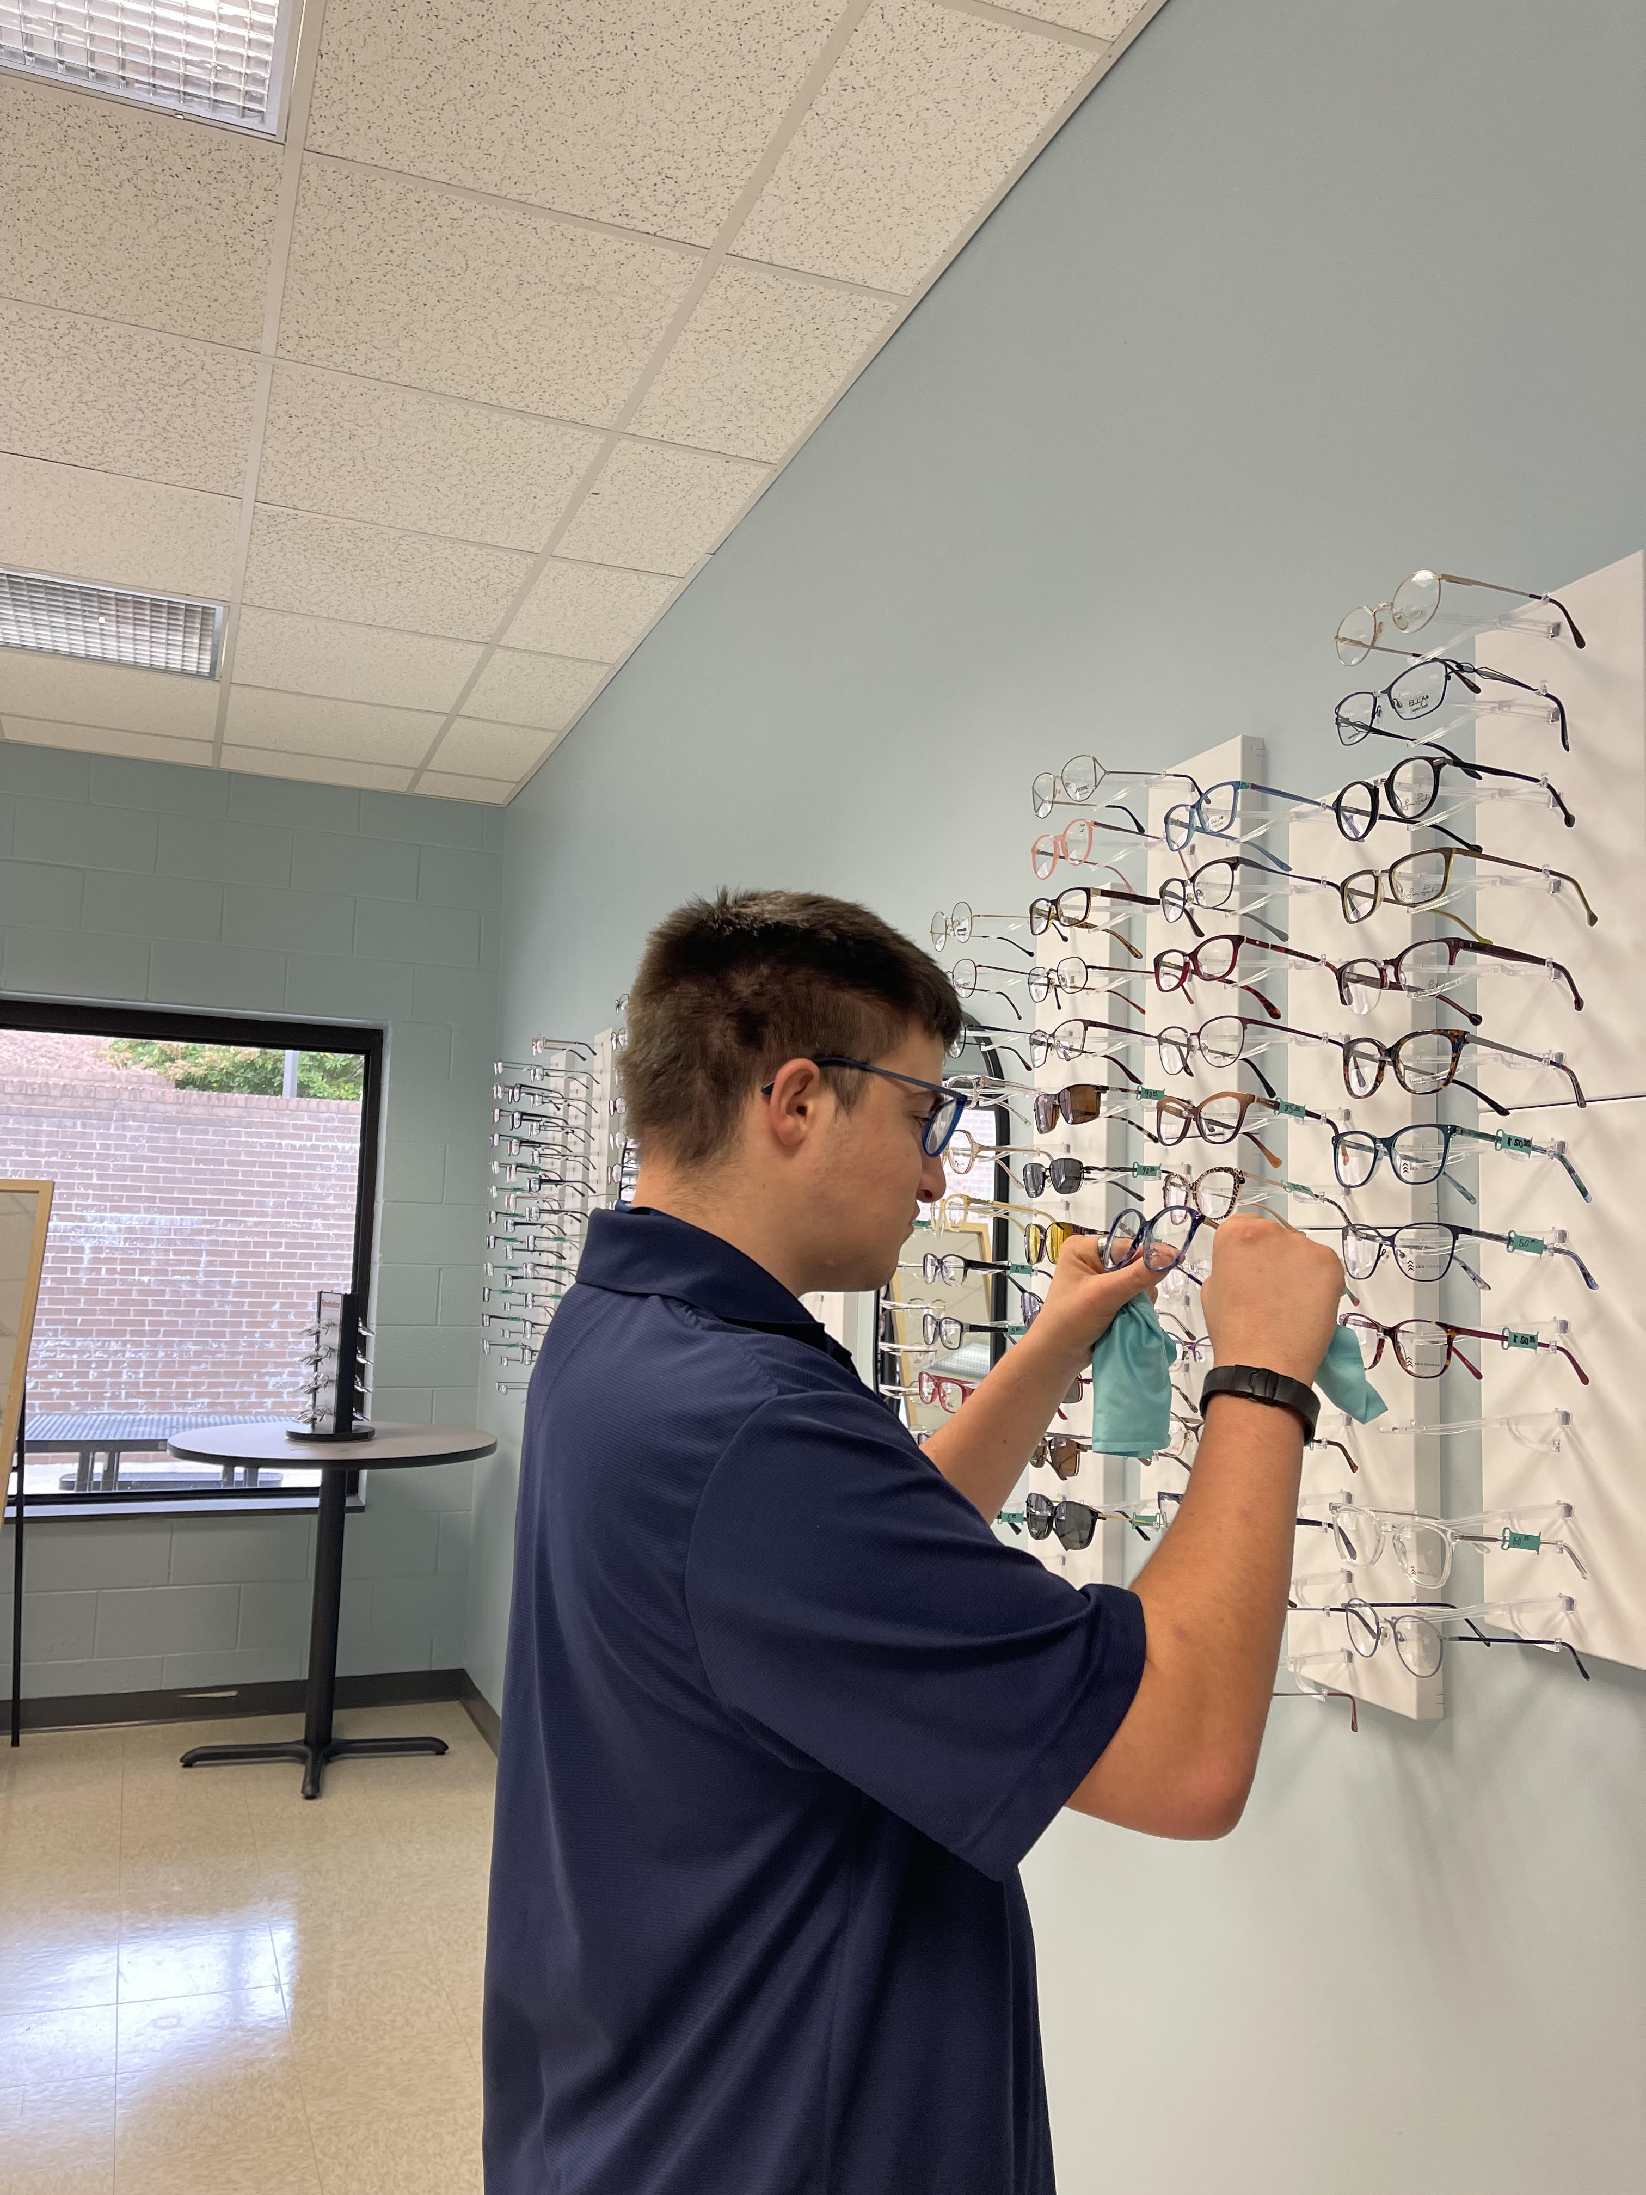
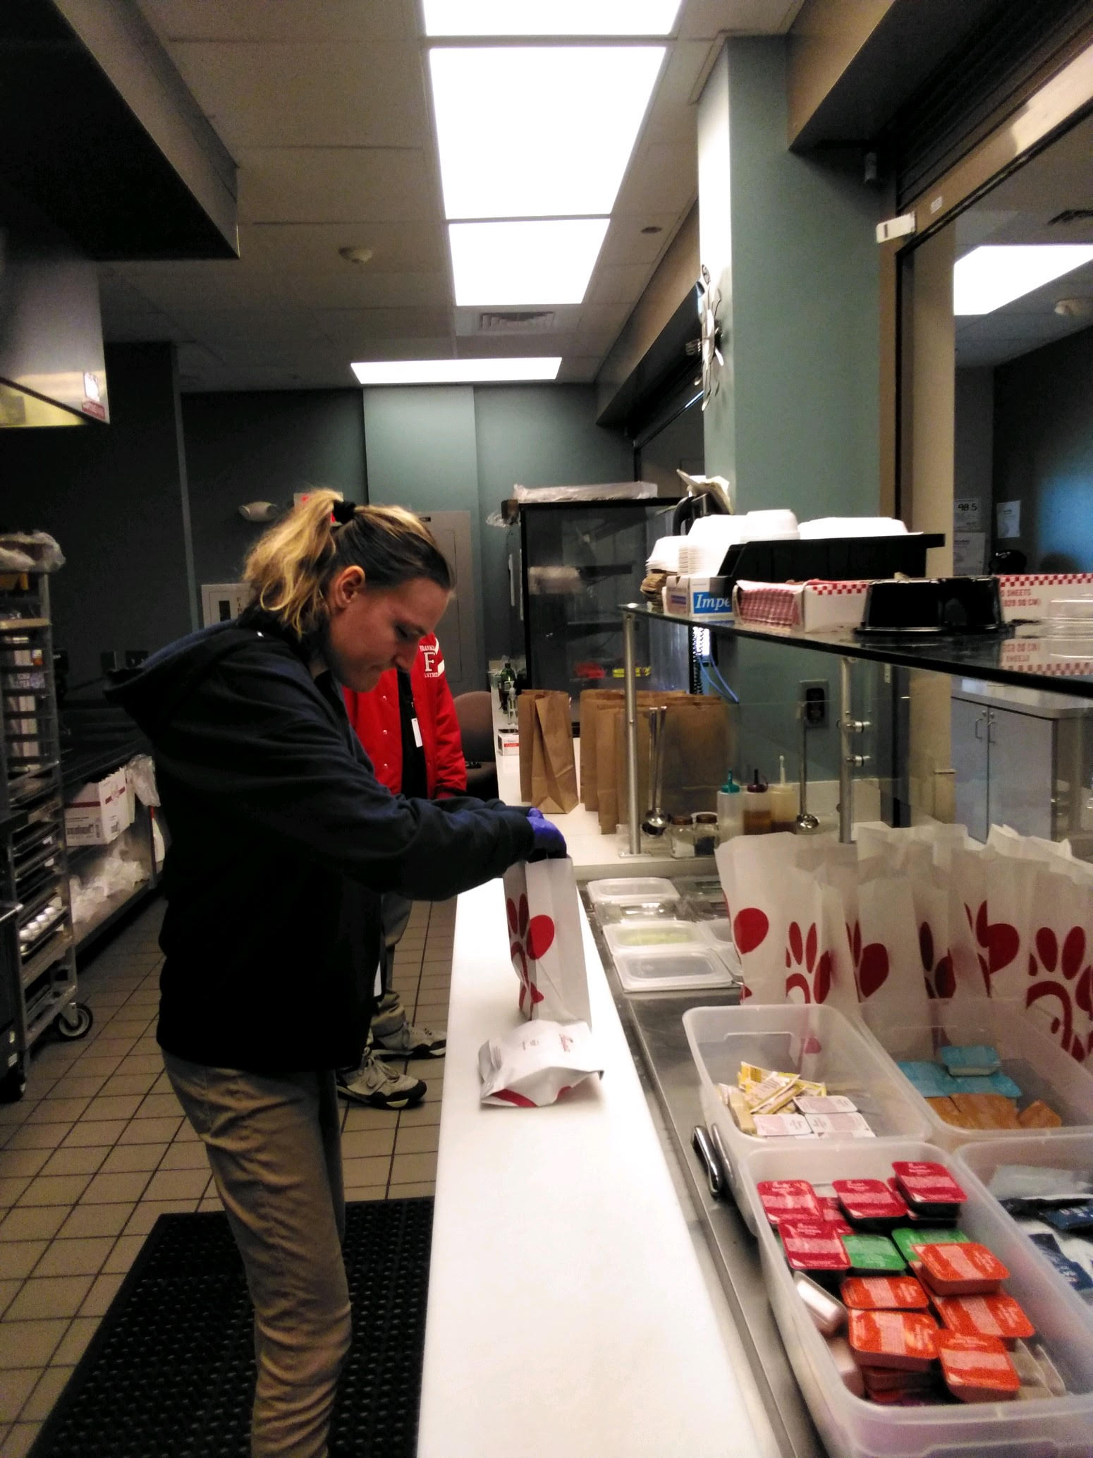
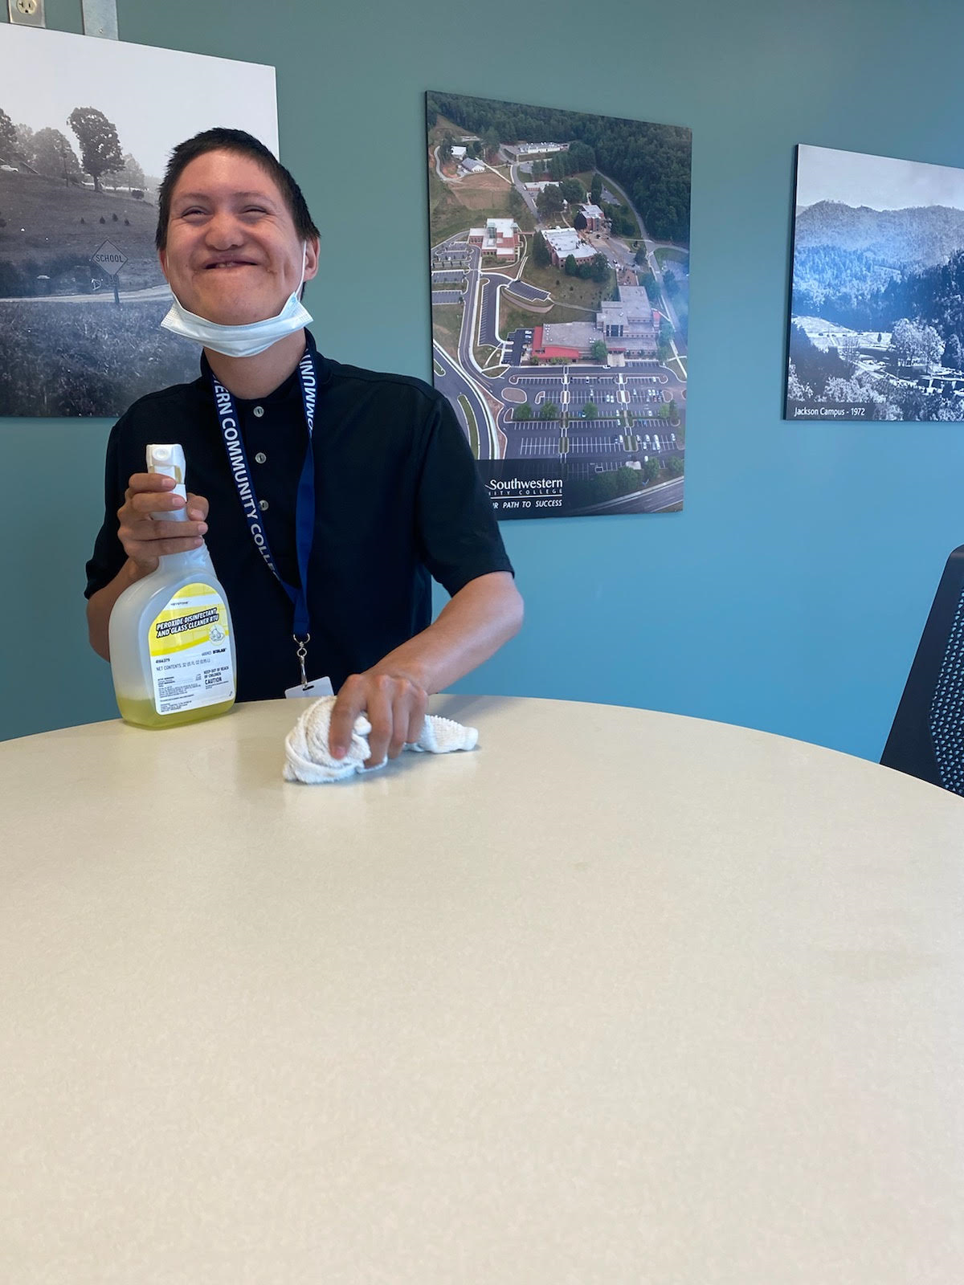
Project SEARCH Interns at work

Slide 10
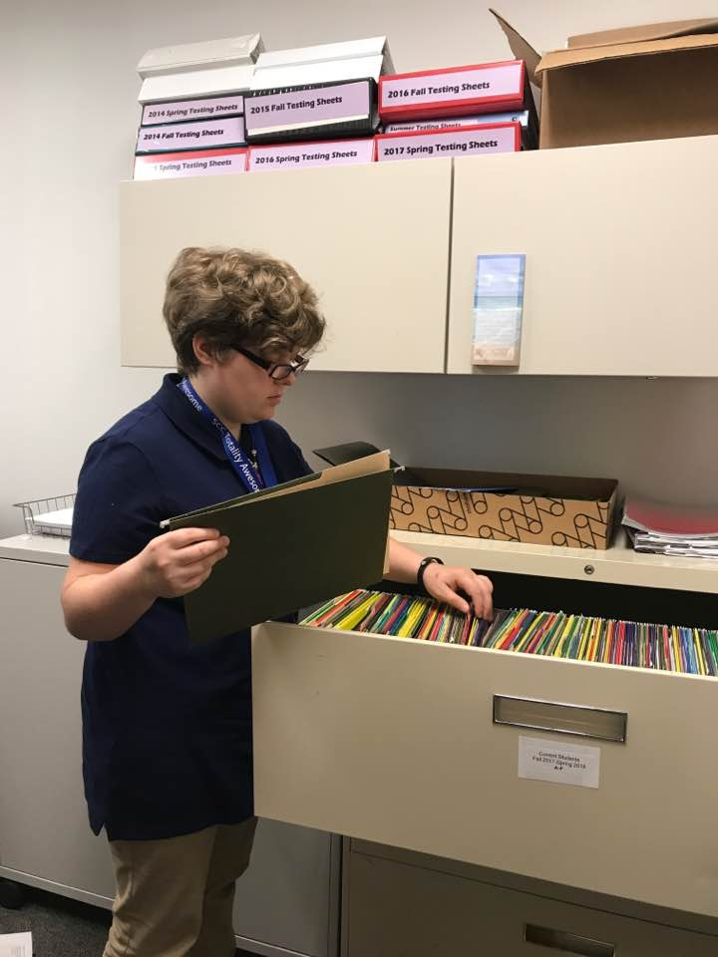

Slide 11
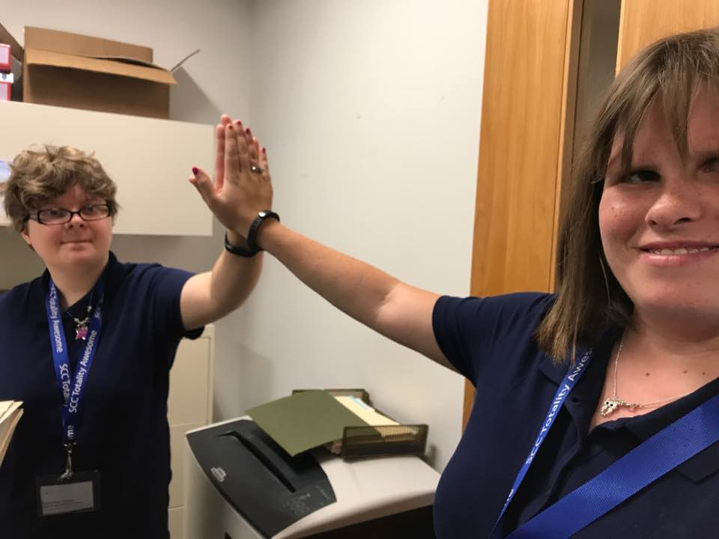
Teamwork!

Slide 12
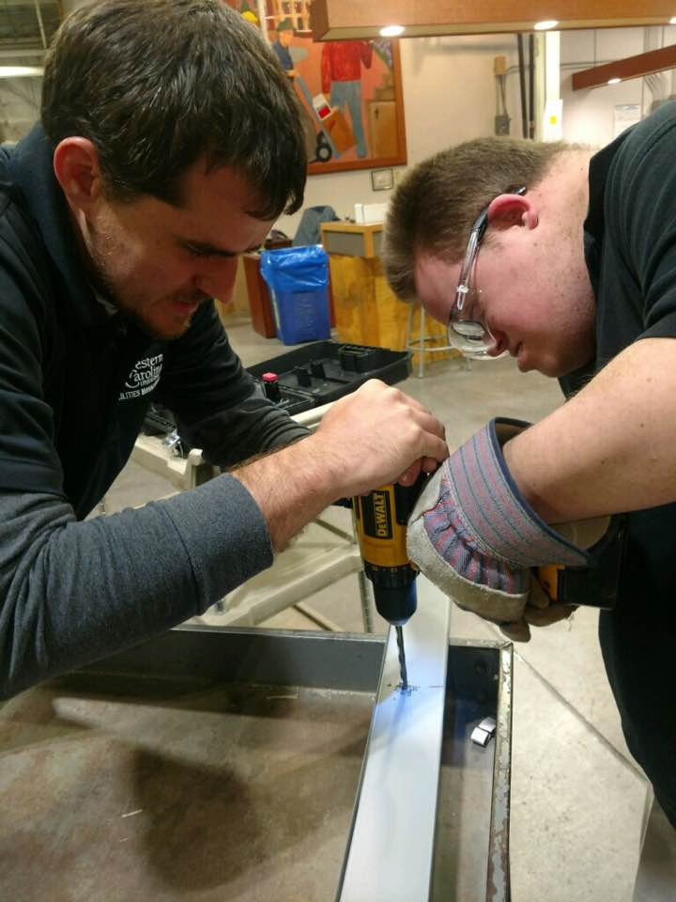
One of the most important
partnerships comes through the
department supervisor/mentor
each intern works with.

Slide 13
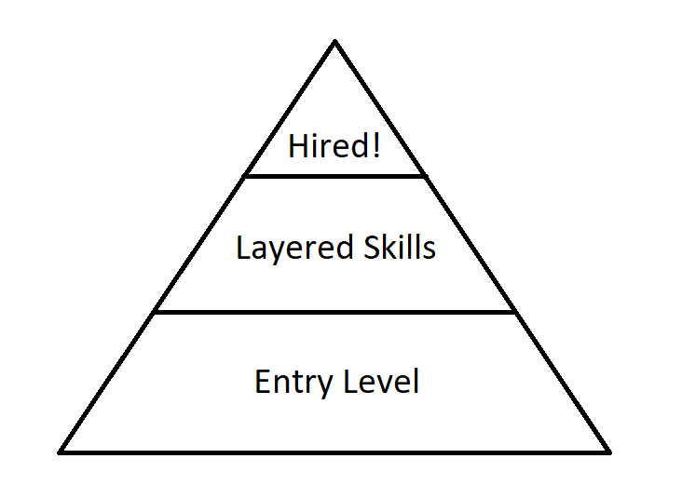

Slide 14
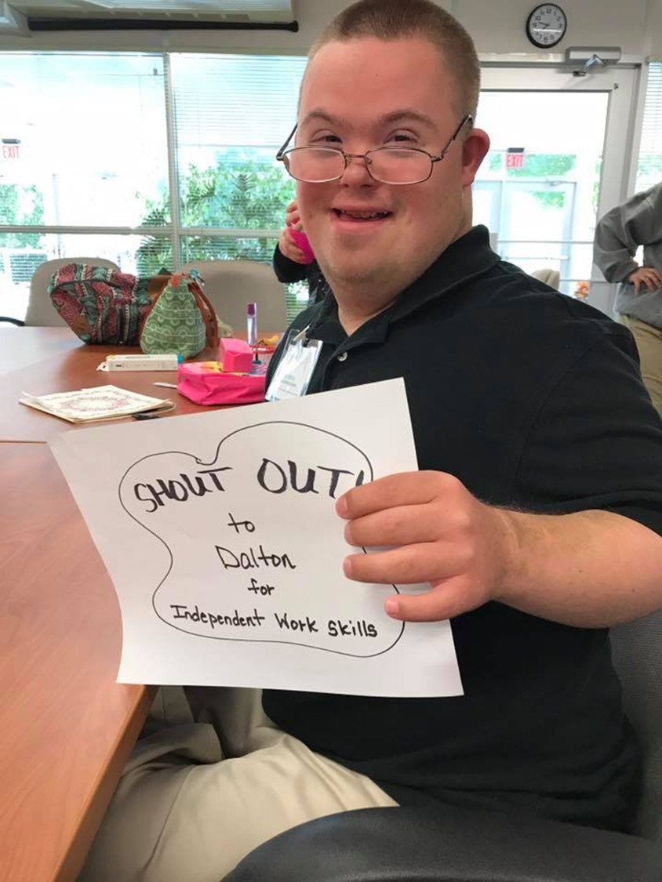
Shout Outs
We teach the interns to do more than good, to go above and beyond. When we feel an intern has done that they get a shout out! This promotes pride in a job well done and encourages them to always strive for more.

Slide 15
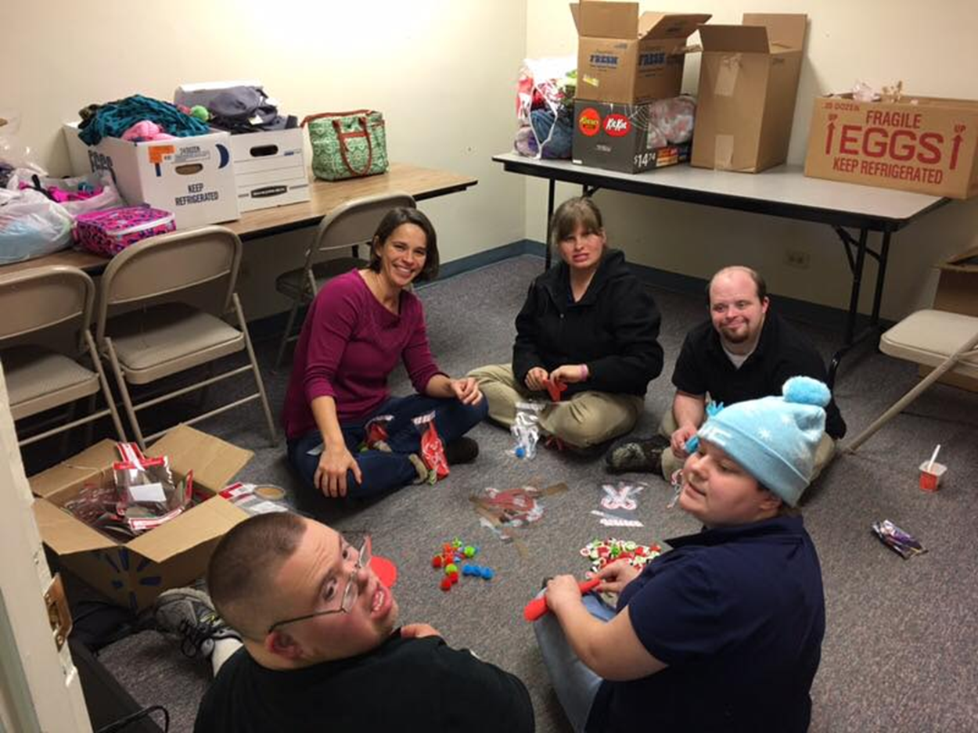
Community Service
Each year we do multiple community service projects throughout the community to instill the importance of giving back. The interns eagerly wait for these days!

Slide 16
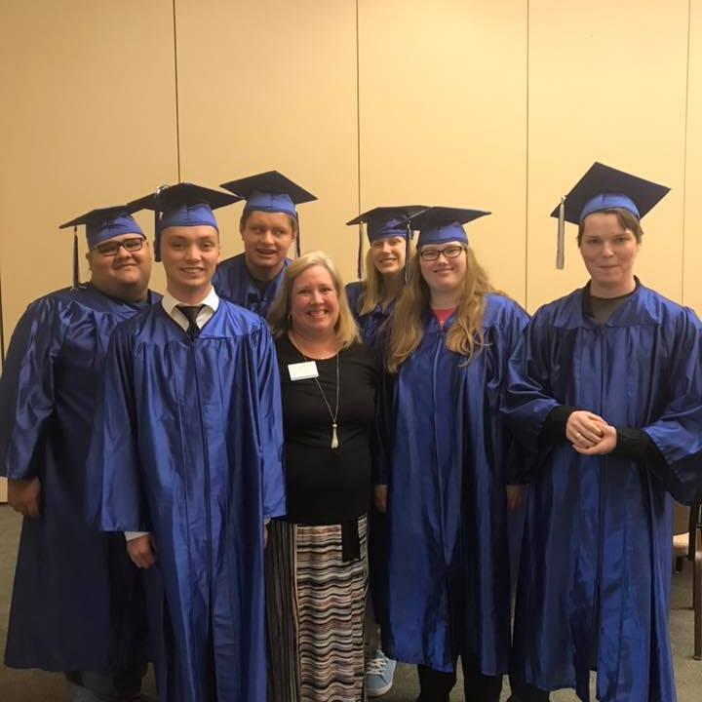

Slide 17
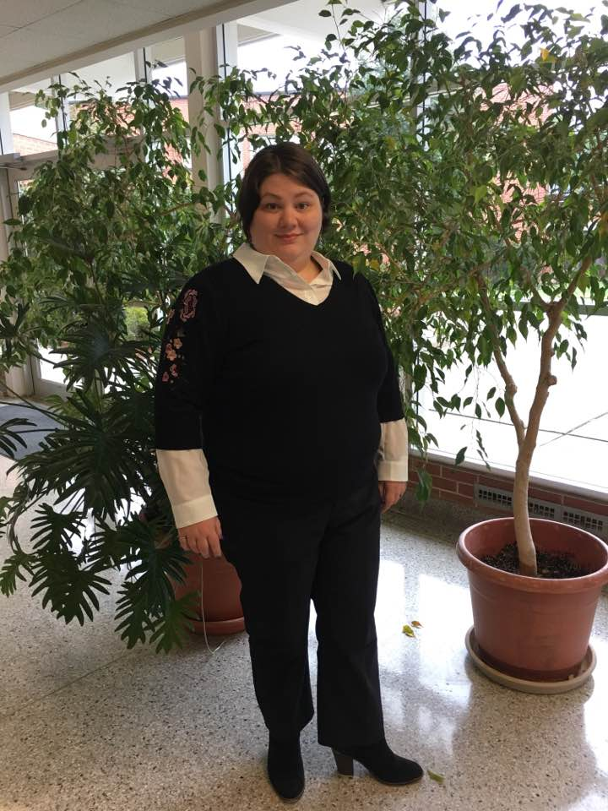
Heading off to an interview

Slide 18
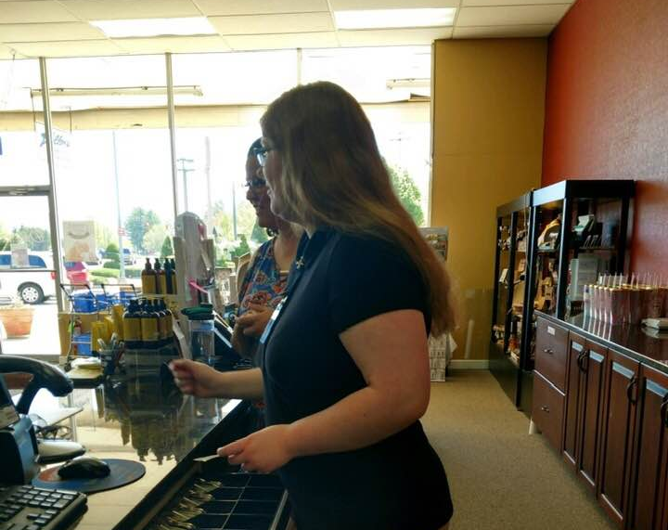
Job placement
We have placed interns into jobs in retail, food service, healthcare, a library, a movie theater, a hotel, a print shop, two school systems, and landscaping so far.

Slide 19
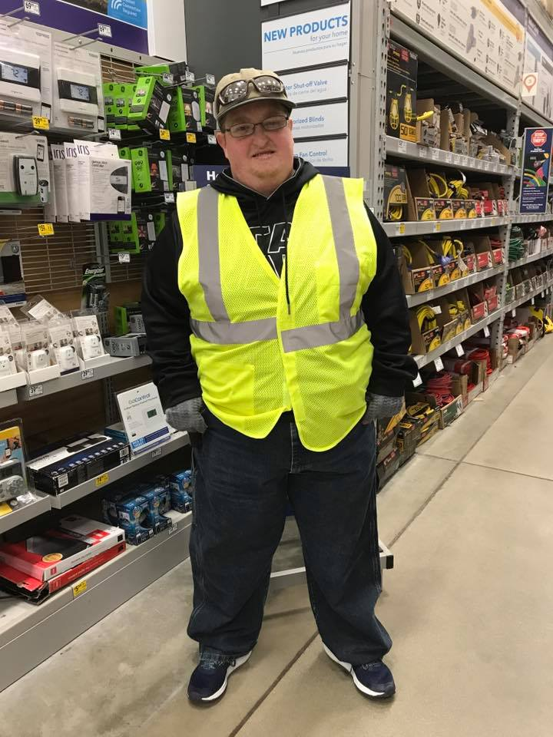
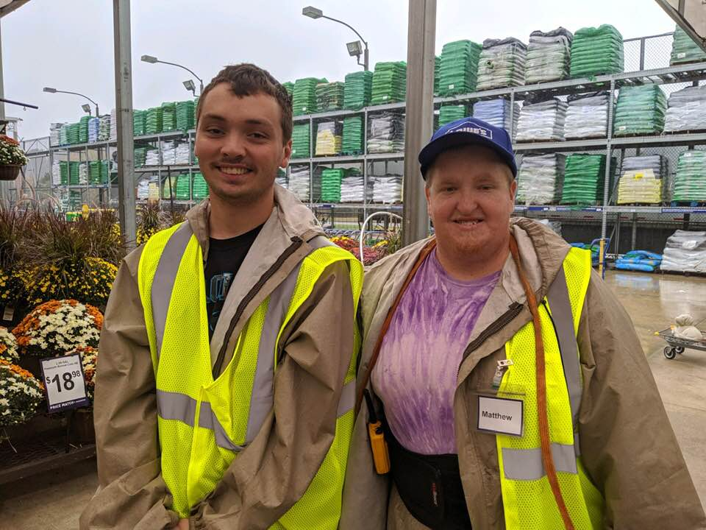
Valued Employees
We are asked for more “Matthew’s” each year!

Slide 20



It’s a Partnership
Families

Slide 21
Project SEARCH Contact information
Devonne Jimison, Coordinator/Lead Teacher for Sylva Project SEARCH
devonnej@southwesterncc.edu 828-339-4361

